Slide 1

Team ACRV
Ankita Sharma
Chinmayee R S
Chiluveru Rajeshwari
Chidrapu Vasantha
Submitted to : Rikki sir

Slide 2




MEET THE CREATIVES
Ankita Sharma
Analyst(Team Lead)
Chidrapu Vasantha
Analyst
Chiluveru Rajeshwari
Analyst
Chinmayee R S
Analyst

Slide 3

Google Cloud Platform(GCP)
Google Cloud Platform is a suite of public cloud computing services offered by Google. The platform includes a range of hosted services for compute, storage and application development that run on Google hardware. Google Cloud Platform services can be accessed by software developers, cloud administrators and other enterprise IT professionals over the public internet or through a dedicated network connection.

Slide 4
Google Compute Engine
which is an infrastructure-as-a-service (IaaS) offering that provides users with virtual machine instances for workload hosting.
Compute Engine instance
An instance is a virtual machine (VM) hosted on Google's infrastructure. You can create an instance by using the Google Cloud Console, the google cloud command-line tool, or the Compute Engine API.
Compute Engine in GCP
Google Compute Engine (GCE) is an Infrastructure as a Service (IaaS) offering that allows clients to run workloads on Google's physical hardware. Google Compute Engine provides a scalable number of virtual machines (VMs) to serve as large compute clusters for that purpose.

Slide 5
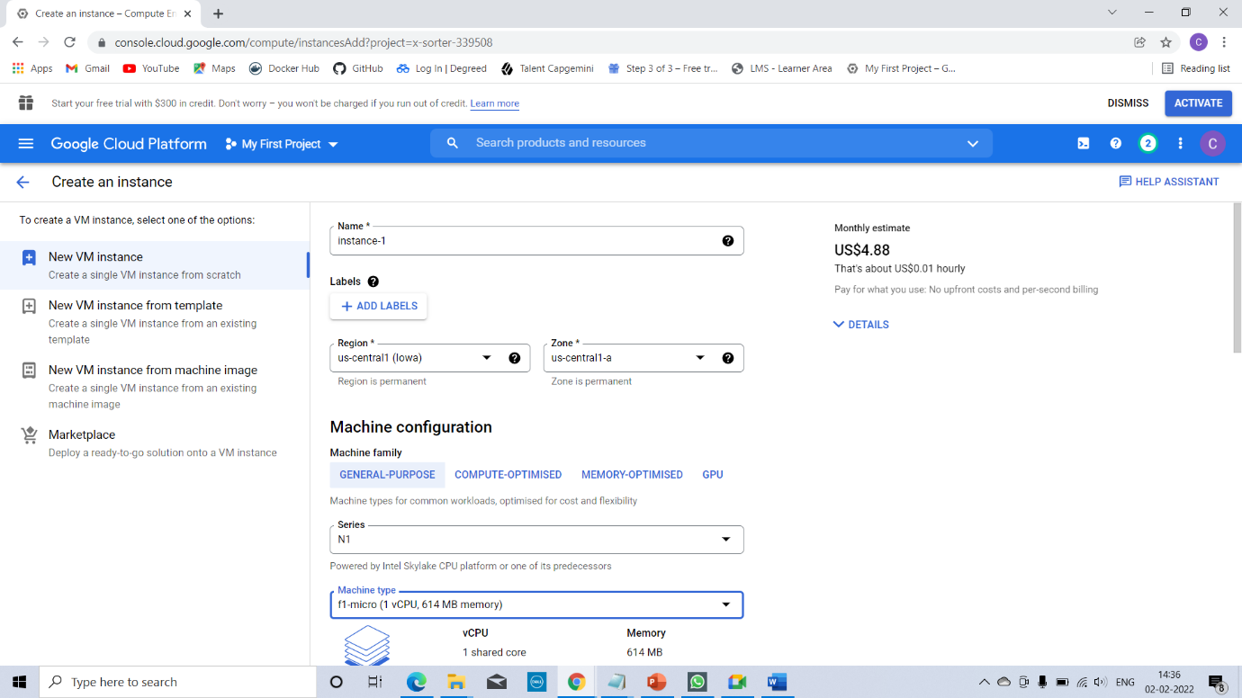
Creating instance in GCP

Slide 6
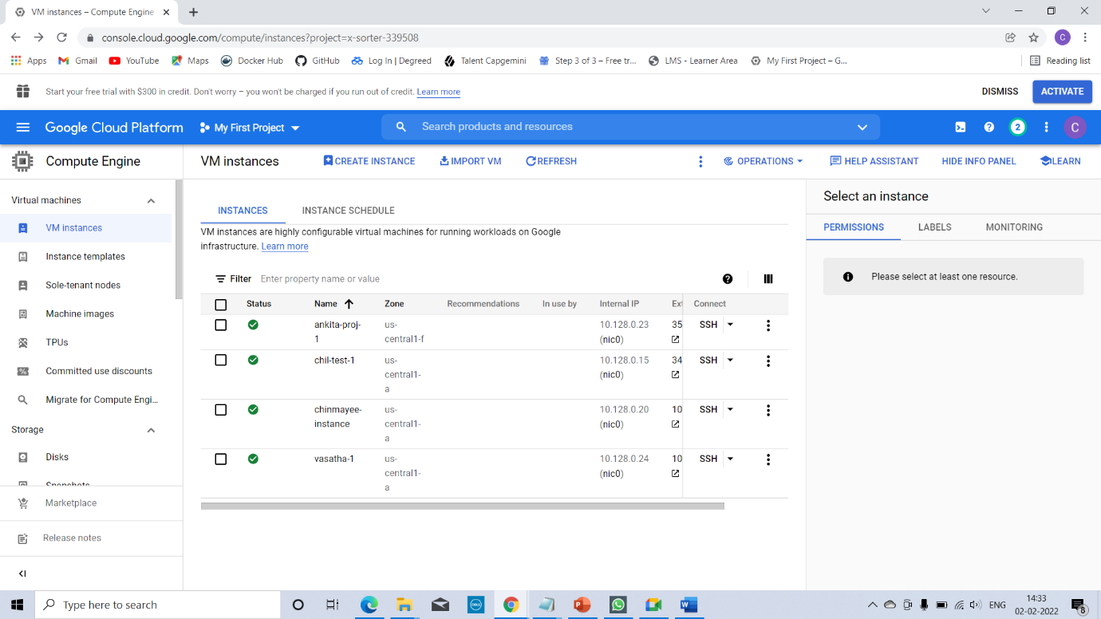
GCP Instance

Slide 7
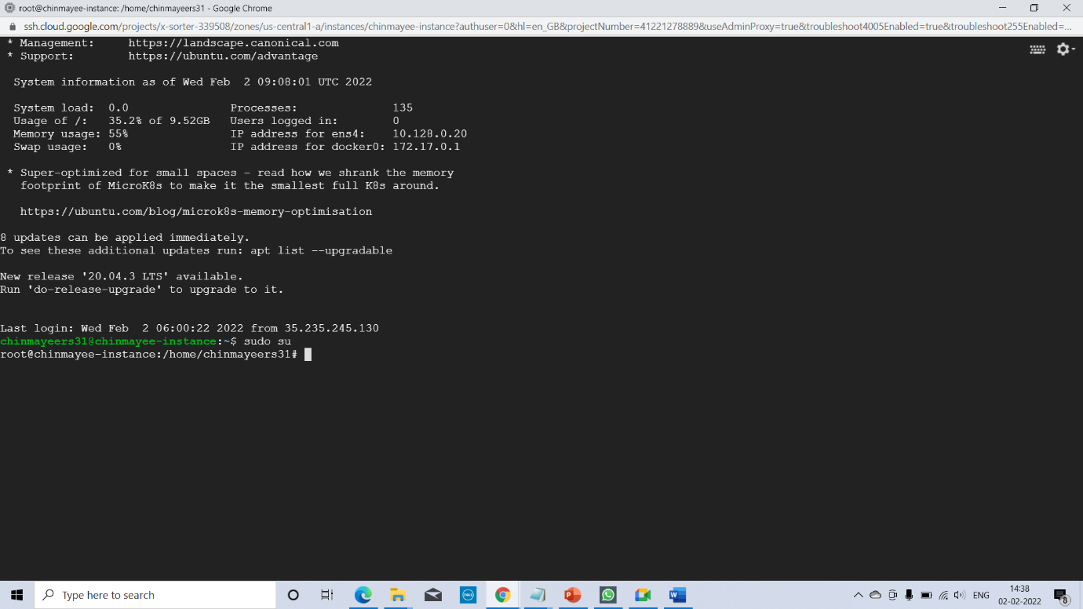
SSH SHELL

Slide 8
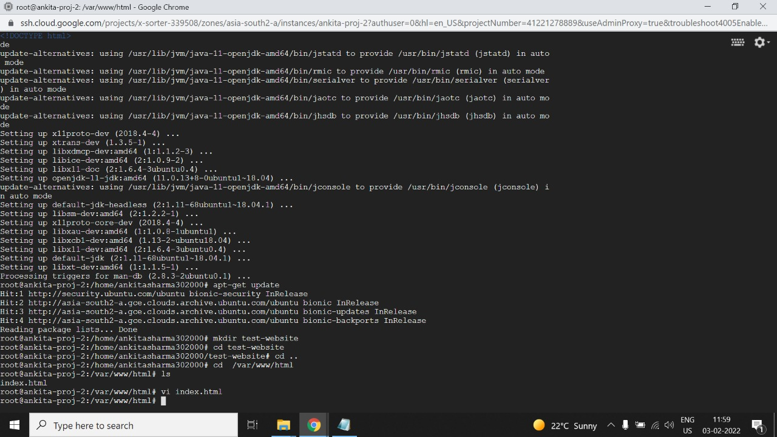
Static website on GCP

Slide 9
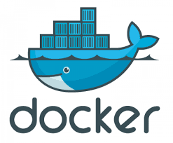
Docker is an open-source platform for developing, shipping, and running applications.
Docker enables you to separate your applications from your infrastructure so you can deliver software quickly.
Docker manages the lifecycle of the container.
The use of containers to deploy applications is called containerization.

Slide 10
History of Docker
Developed using Linux core components, in 2013.
It was developed as an internal project at a platform-as-a-service company called dot Cloud and later renamed as Docker.
Terminologies of Docker
Docker image is built using a dockerfile.
Dockerfile contains all the application dependencies.
Docker container is an instance of a docker image.

Slide 11
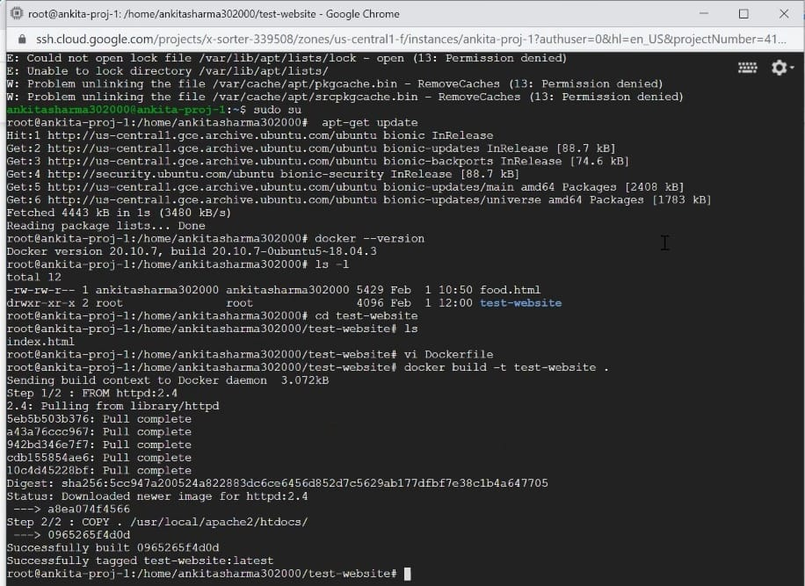
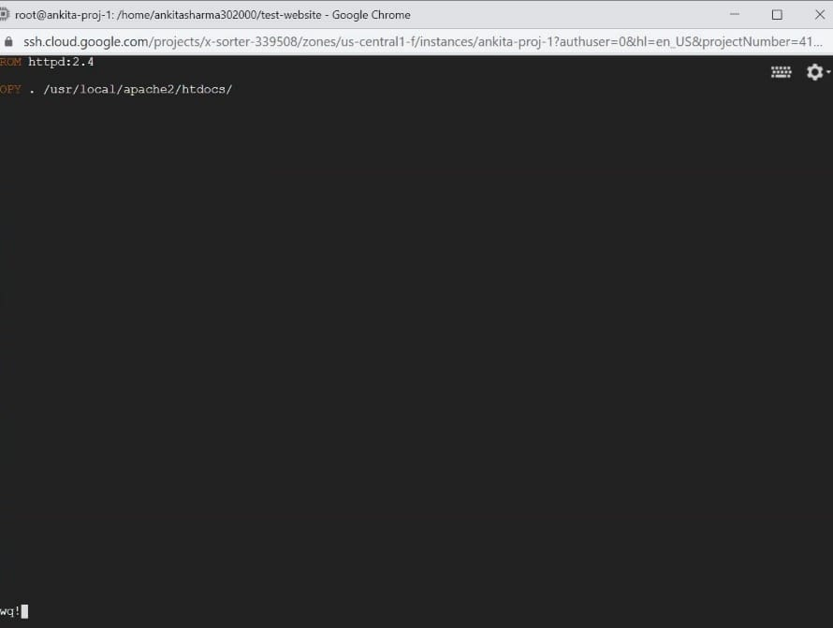
Deployment of website on docker
In SSH

Slide 12
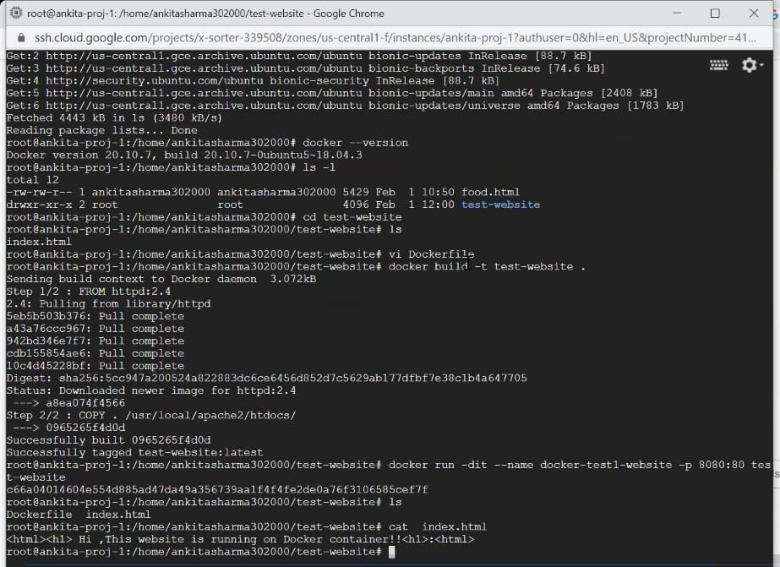
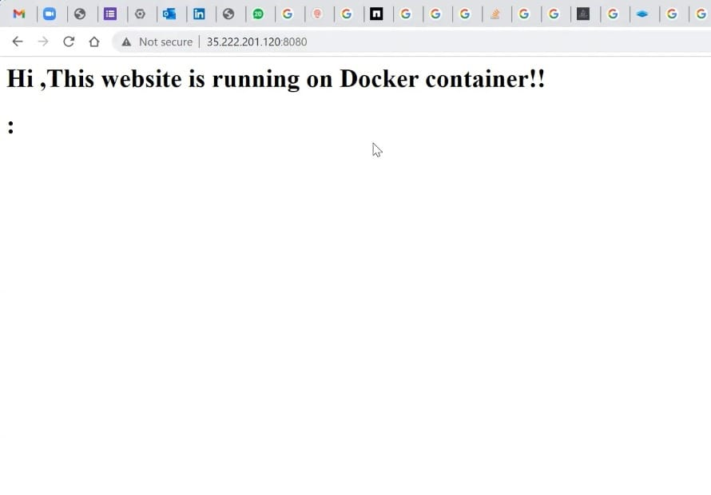

Slide 13
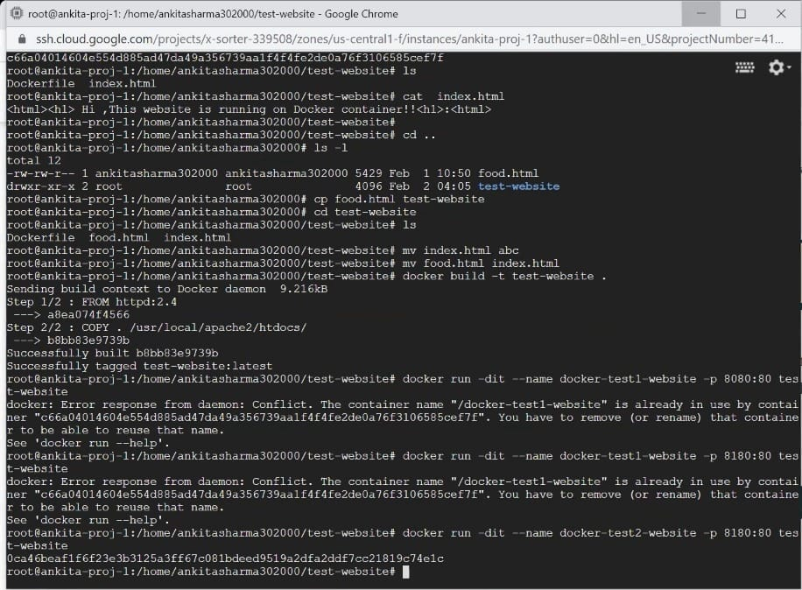

Slide 14
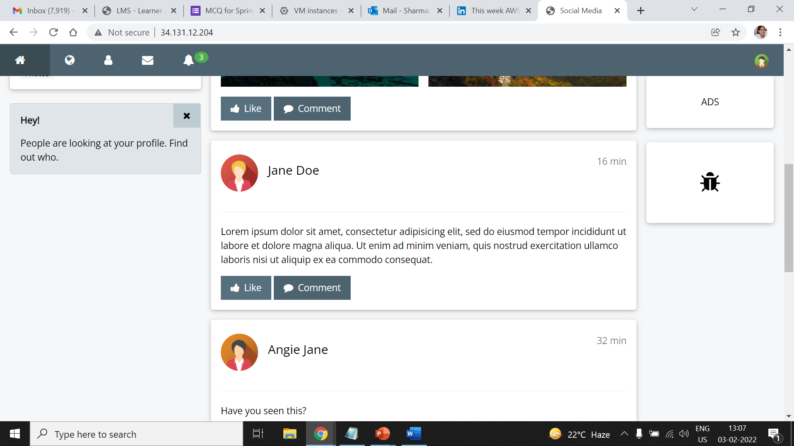
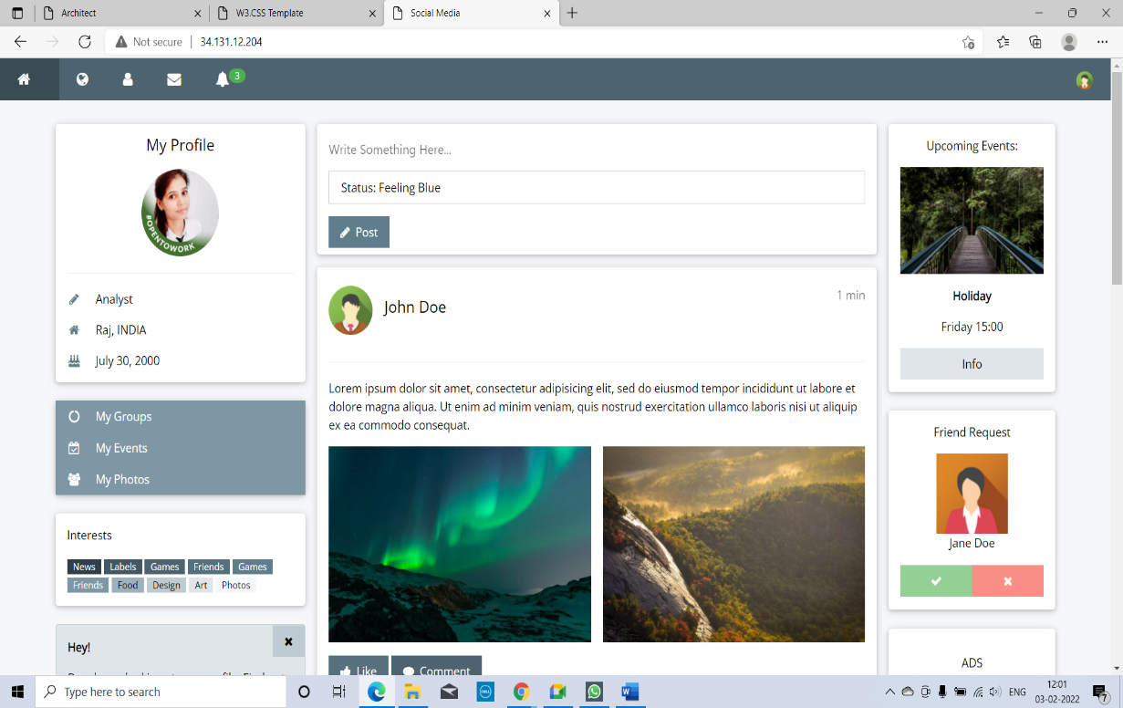
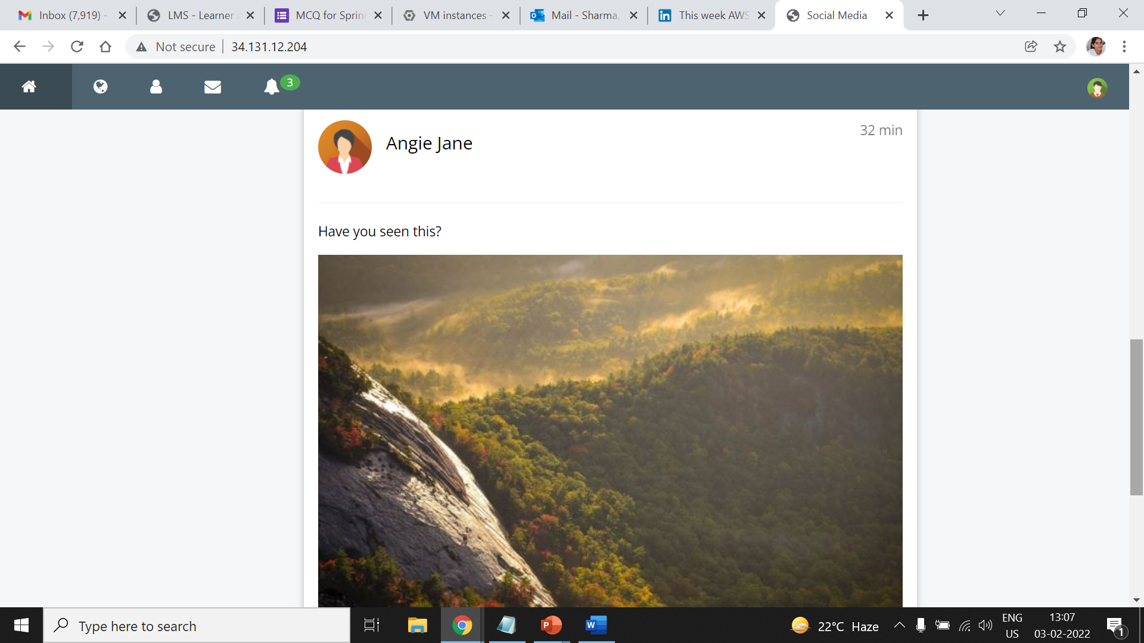
Project 1 :Static website on GCP
http://34.131.12.204/
Ankita-Social Media

Slide 15
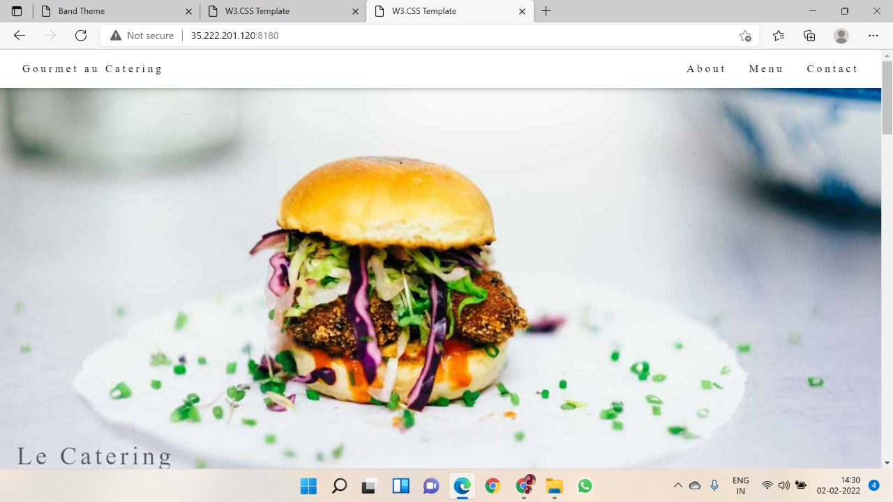
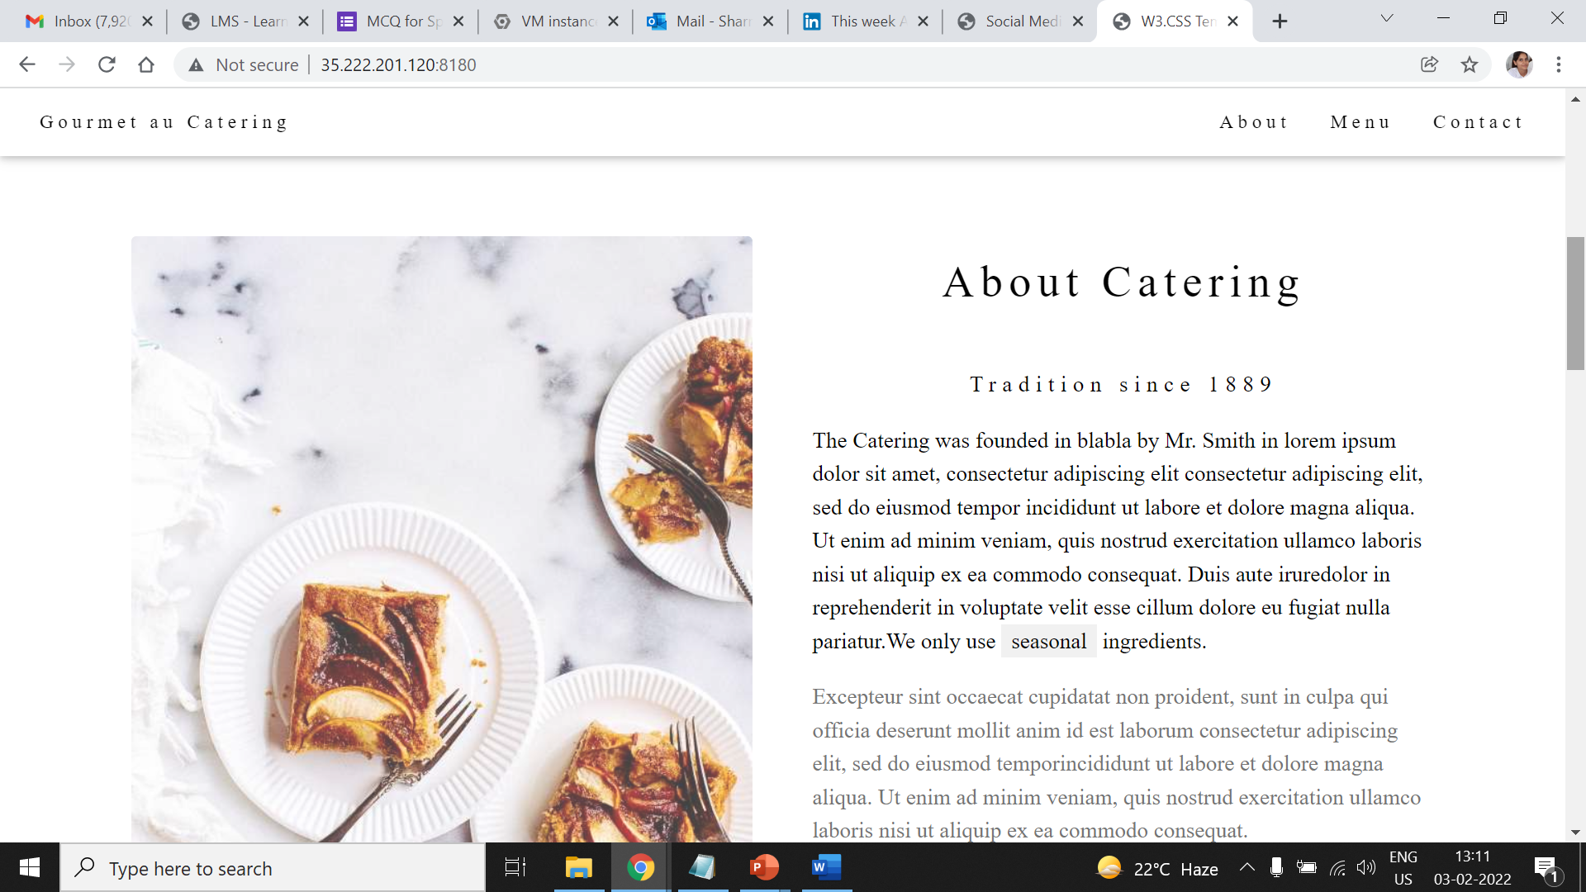
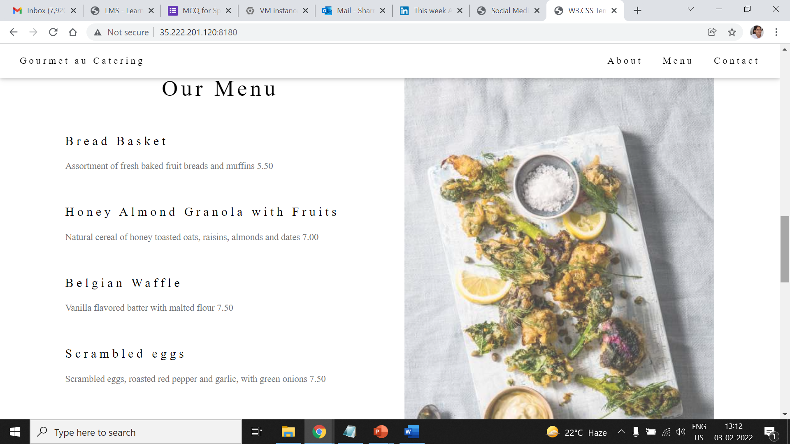
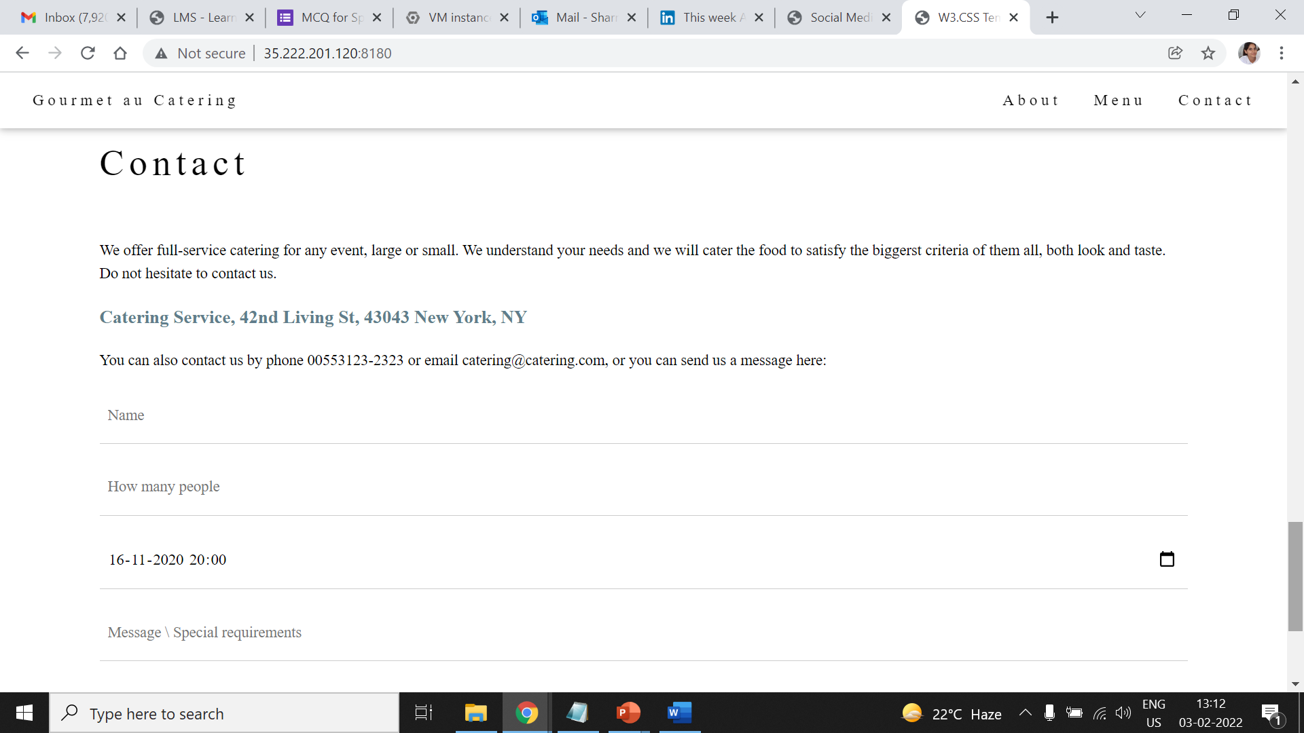
Project 2:Deployment of website on docker
http://35.222.201.120:8180

Slide 16
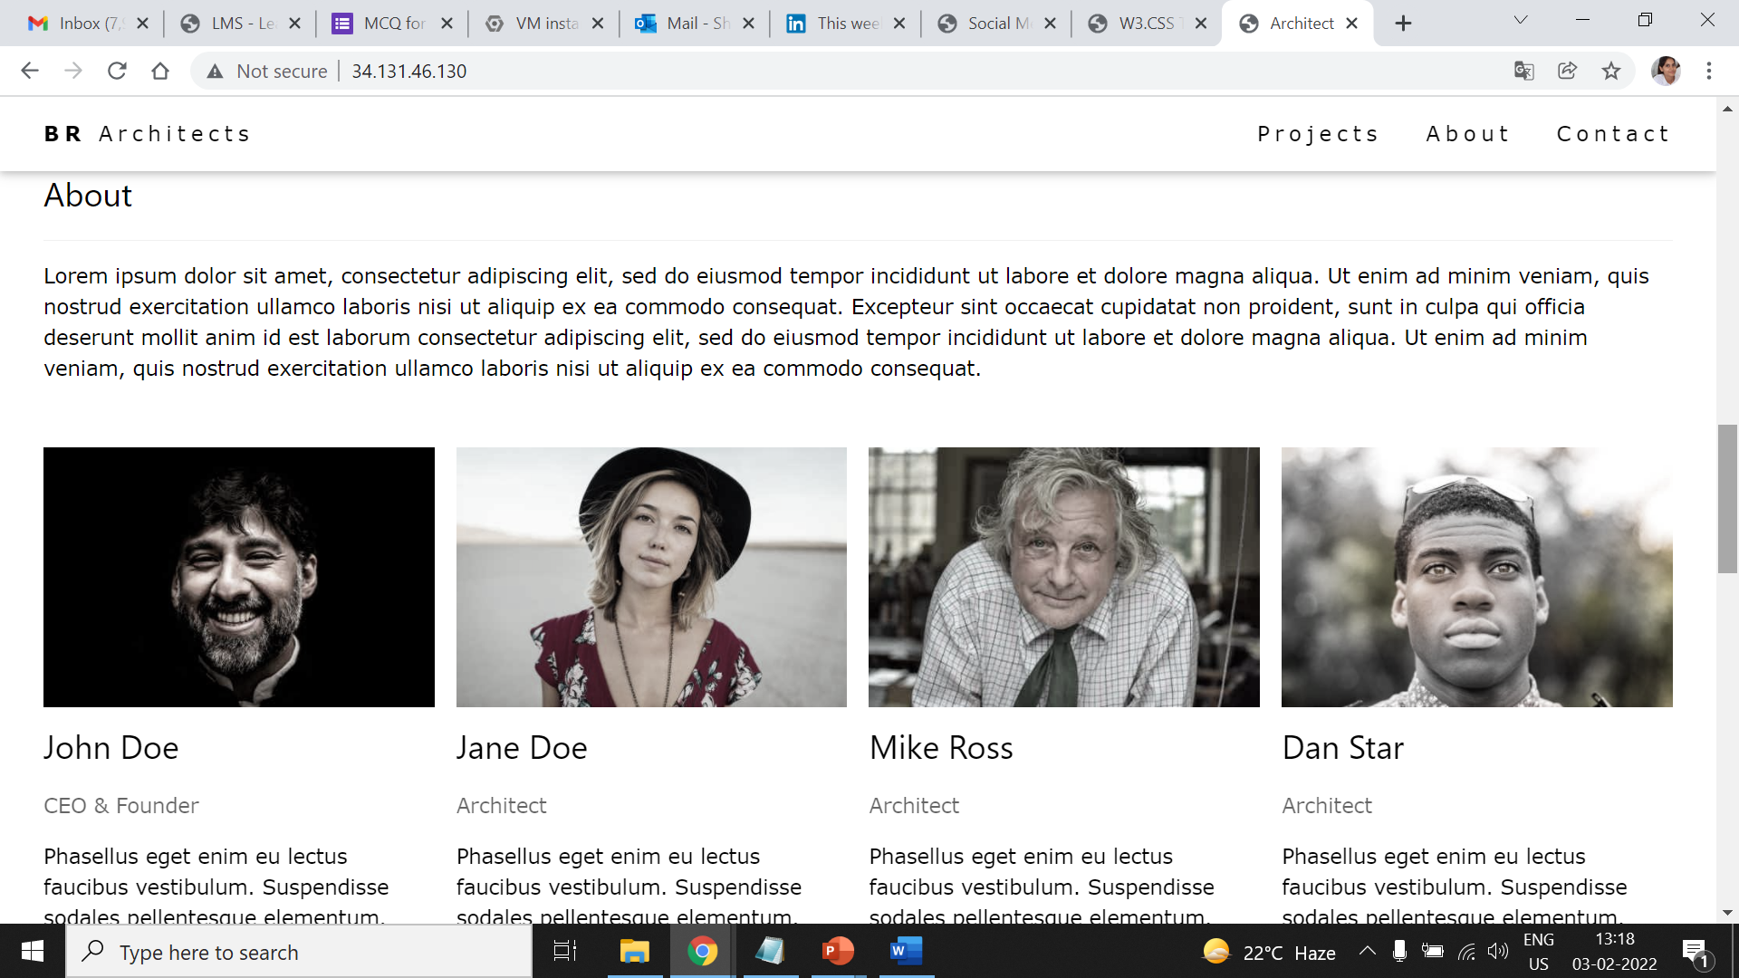
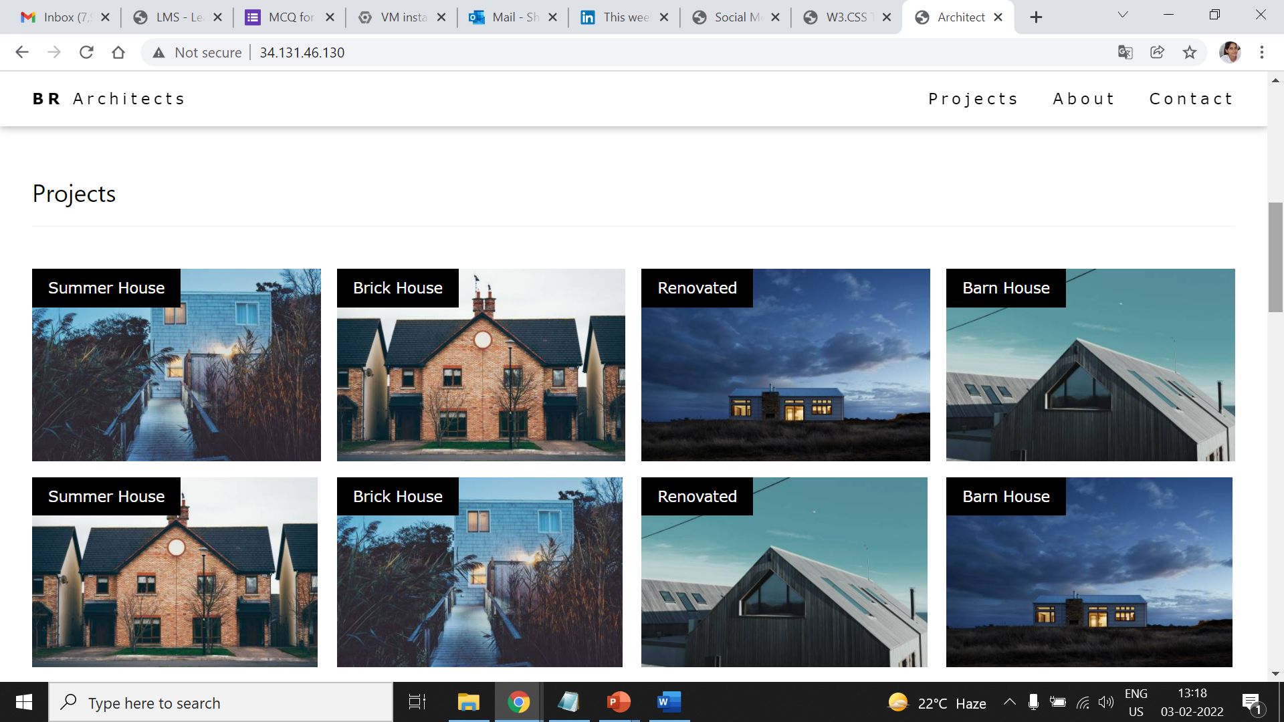
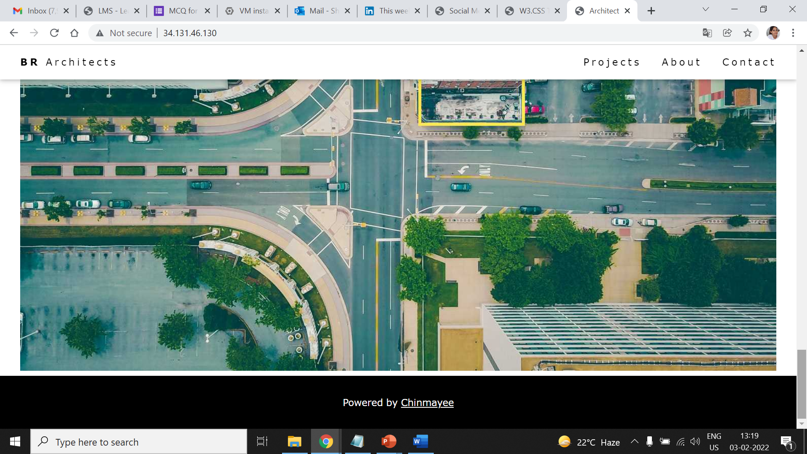
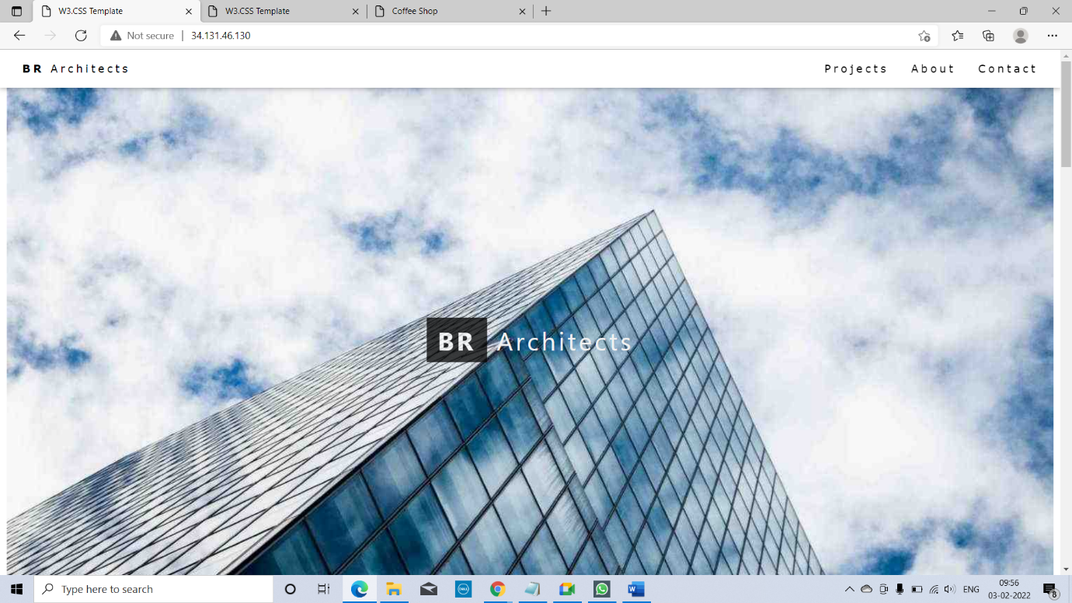
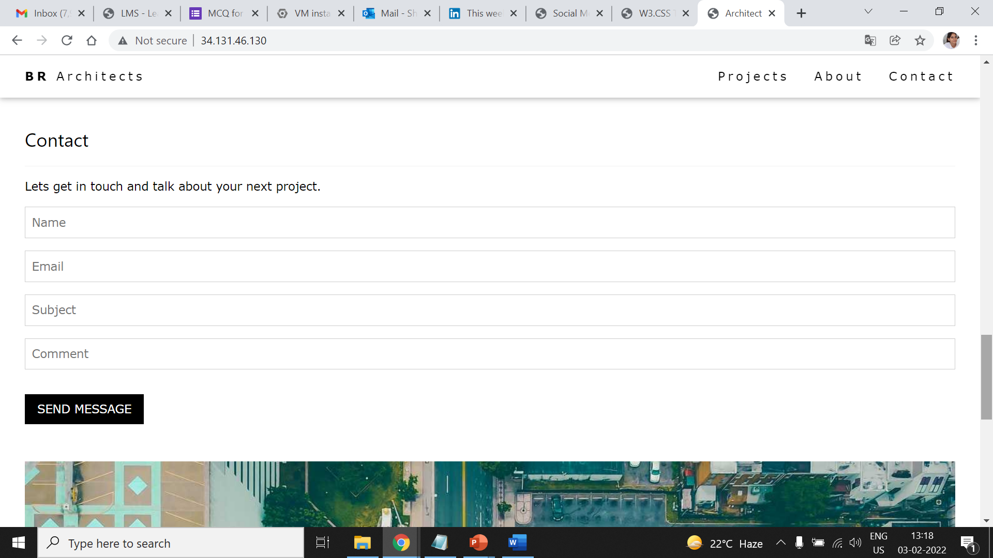
Project 1 :Static website on GCP
http://34.131.46.130/
Chinmayee R S – Architect

Slide 17
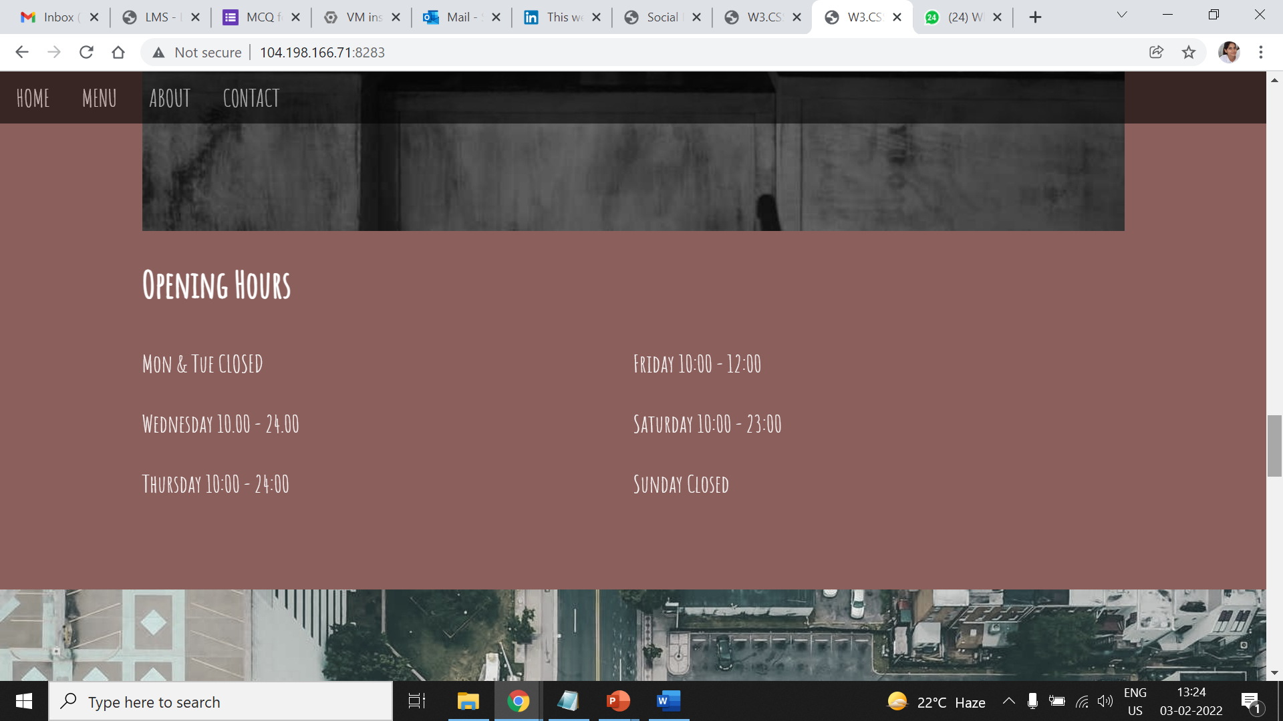
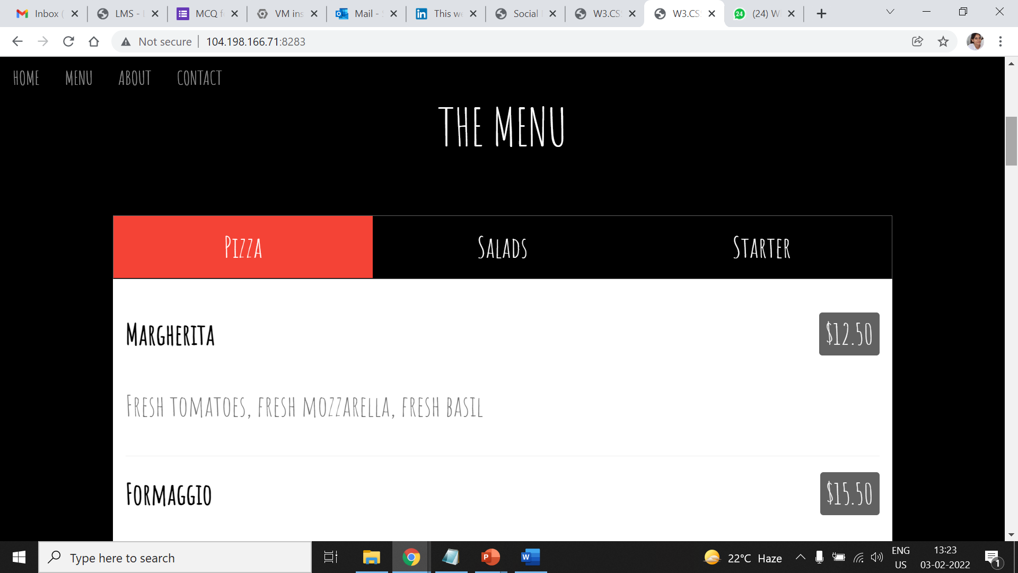
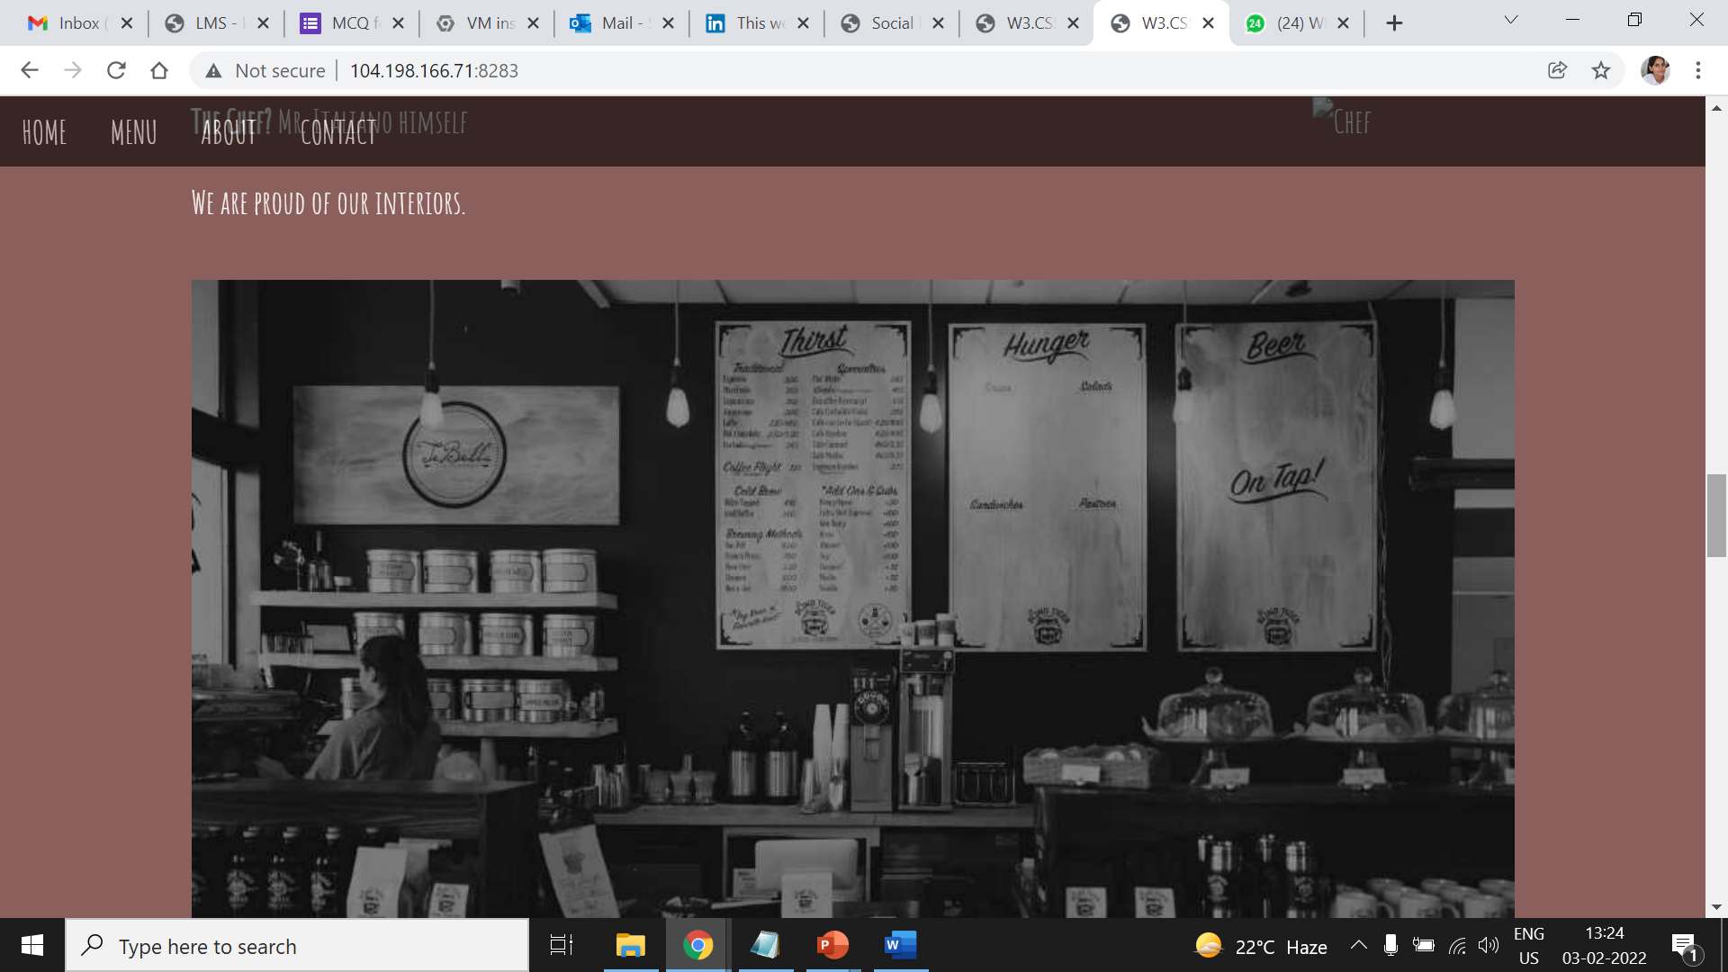
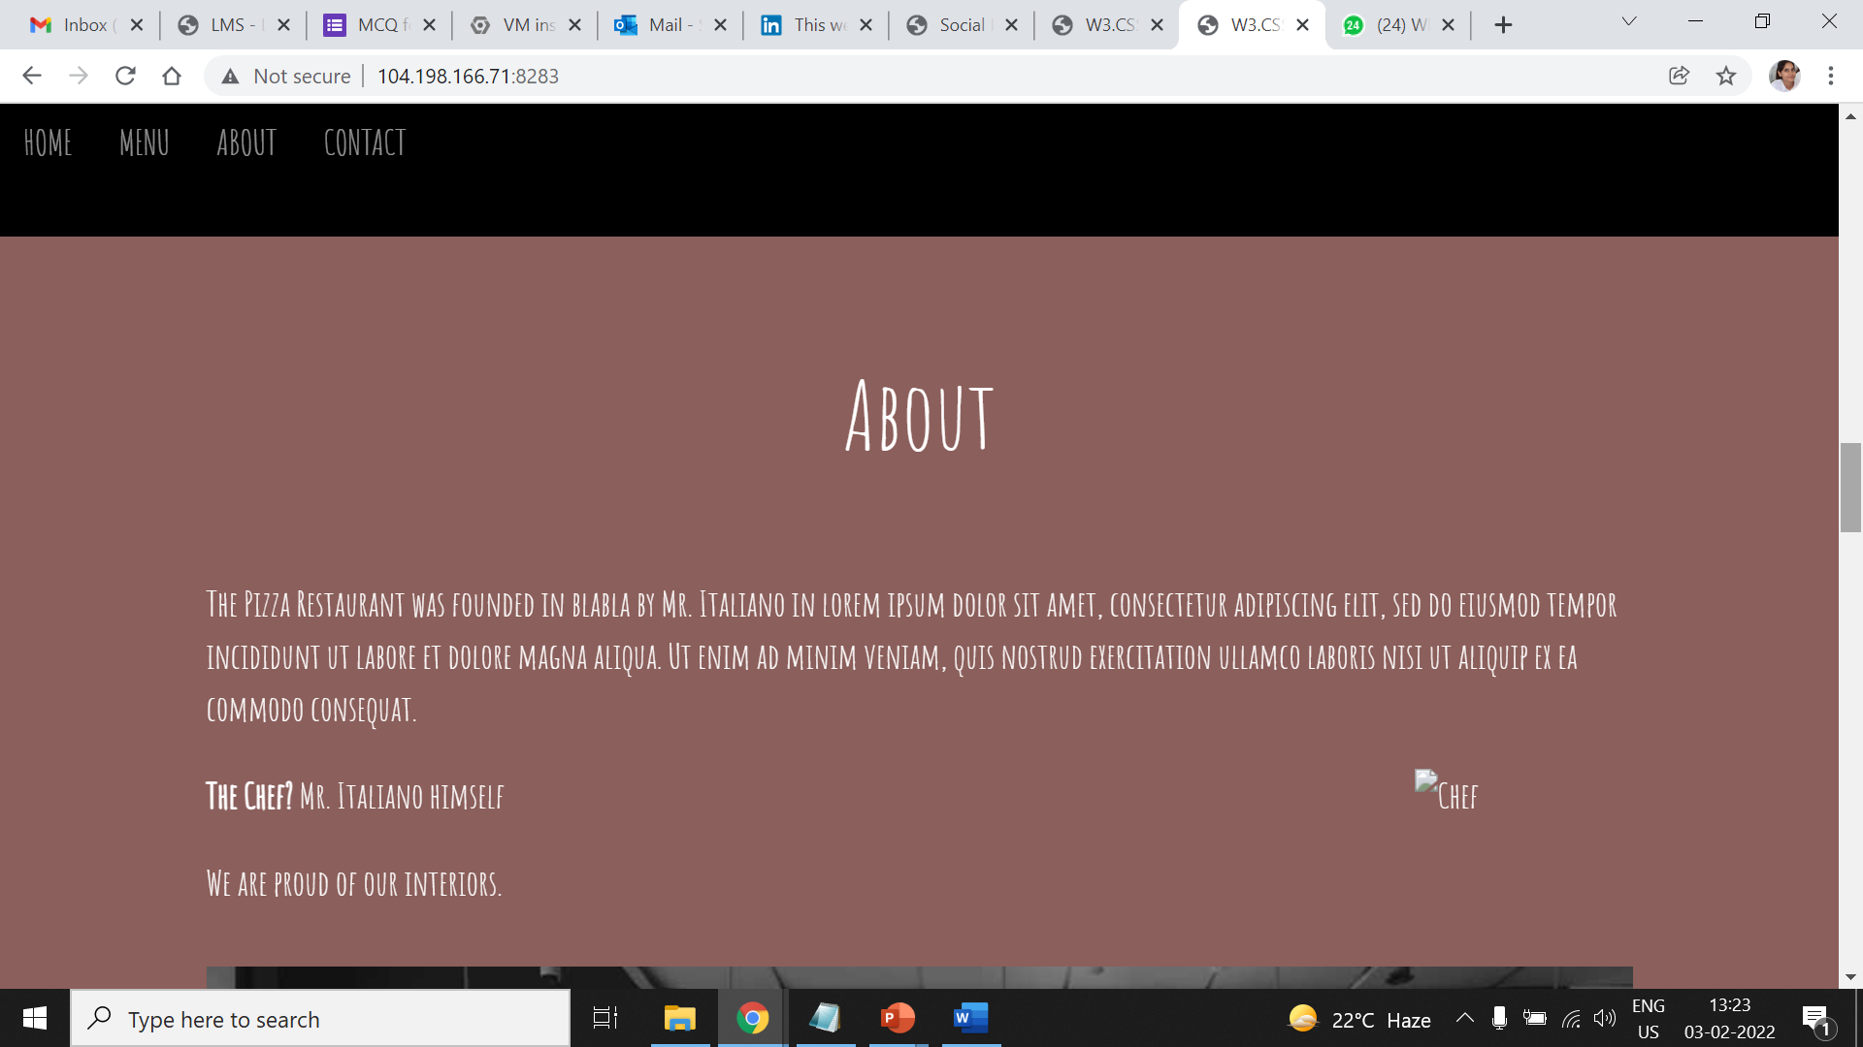
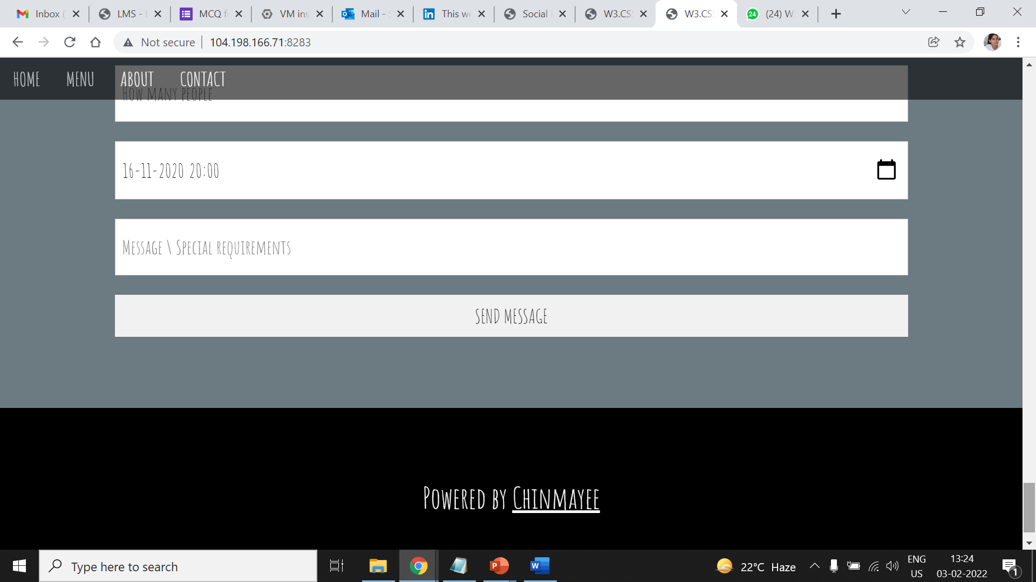

Project 2:Deployment of website on docker
http://104.198.166.71:8283

Slide 18
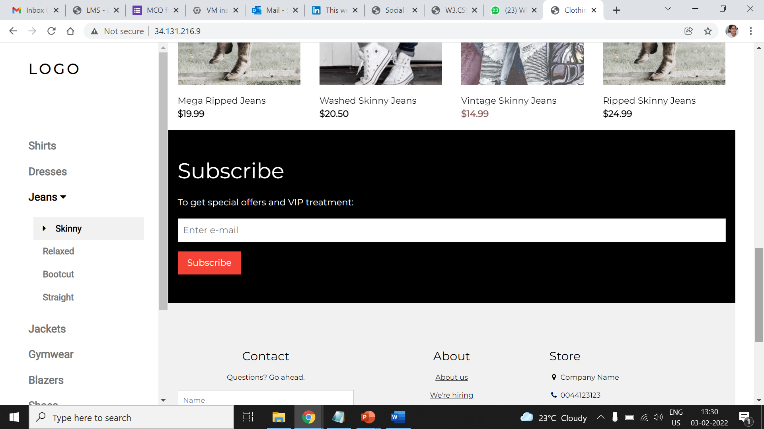
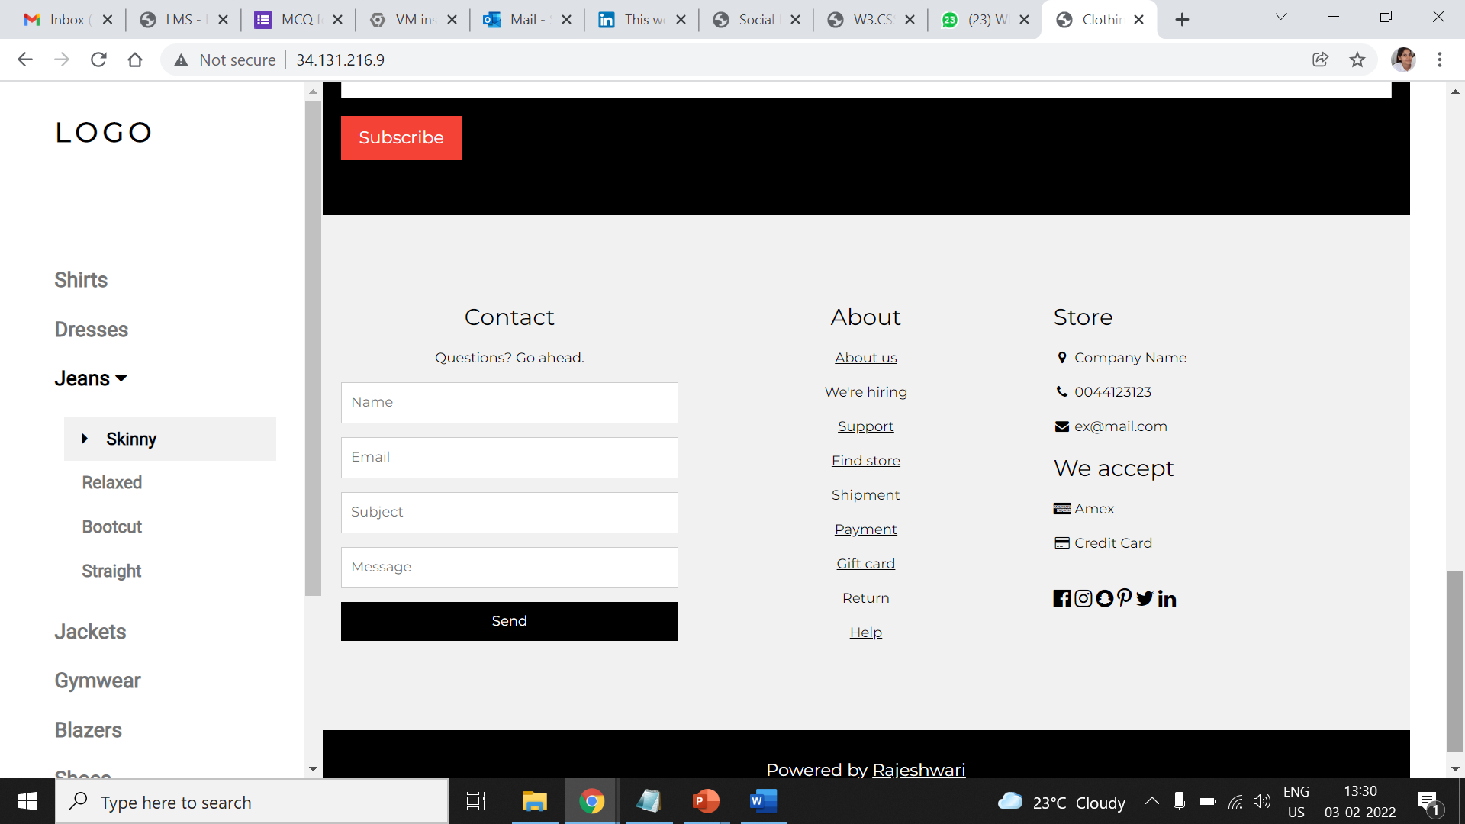
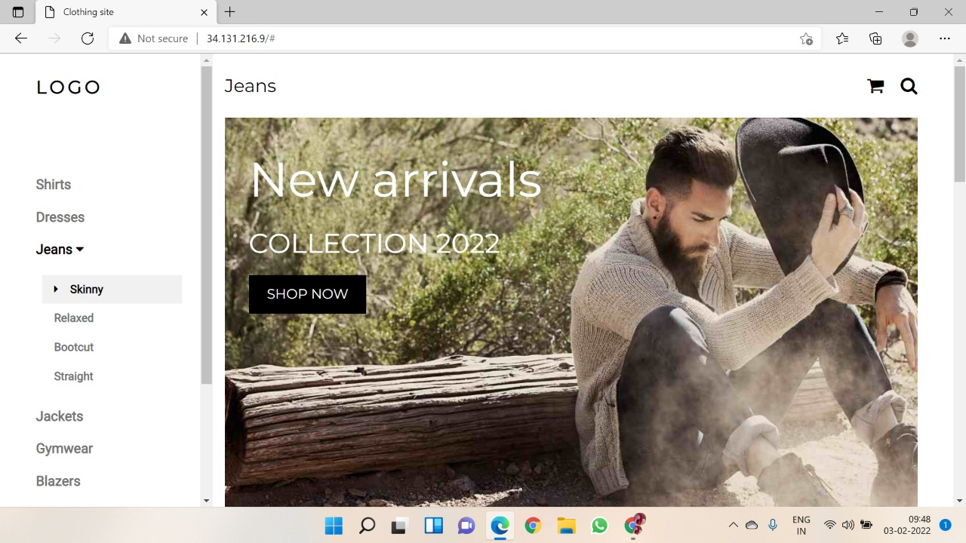
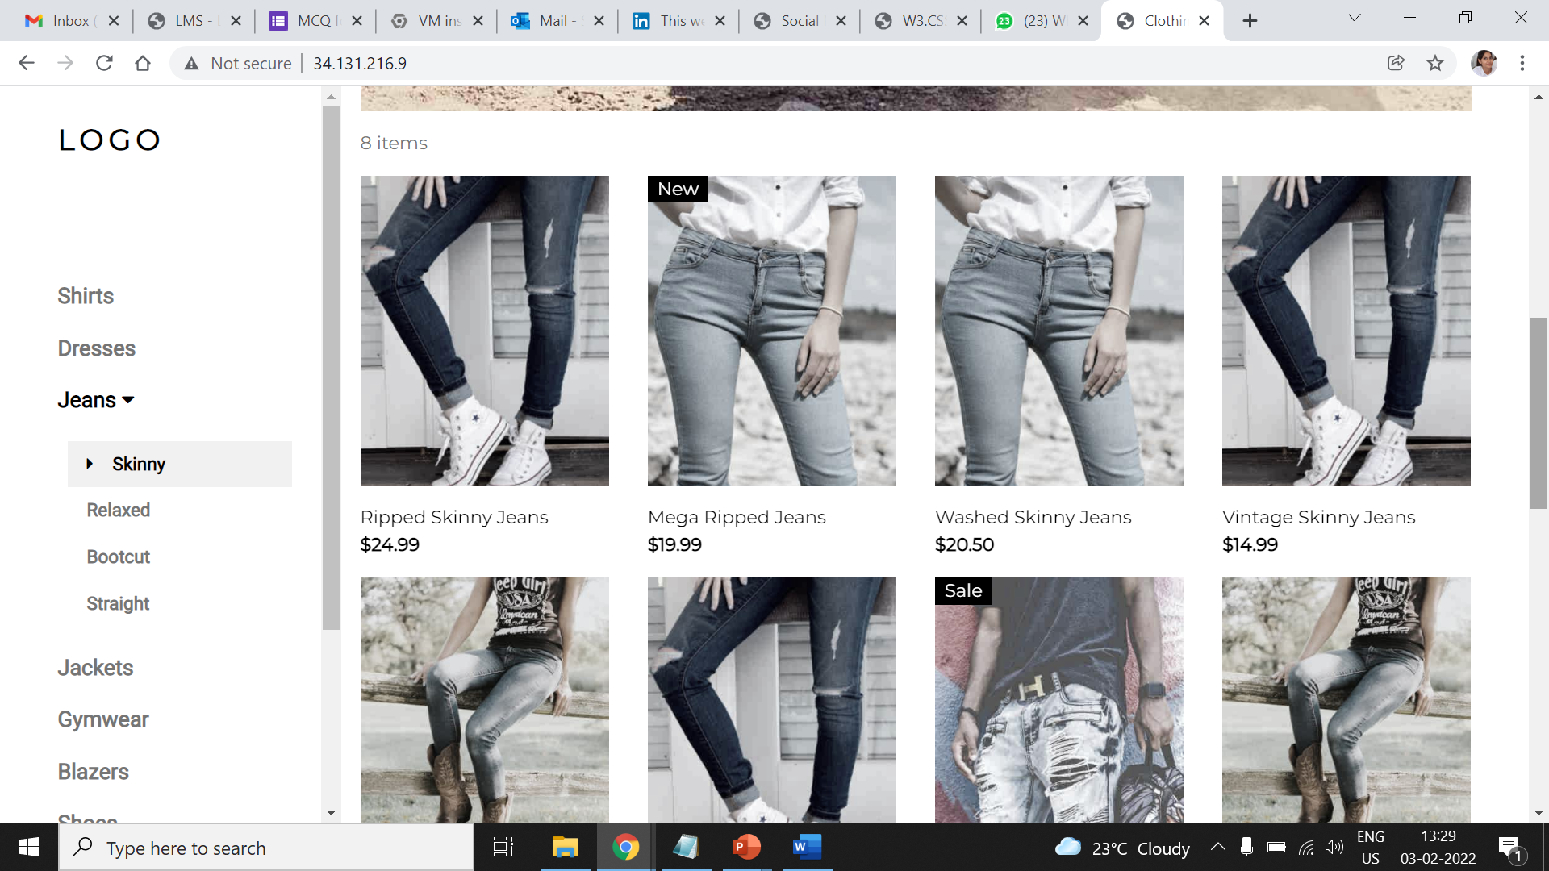
Project 1 :Static website on GCP
http://34.131.216.9/
Rajeswari – Clothing

Slide 19
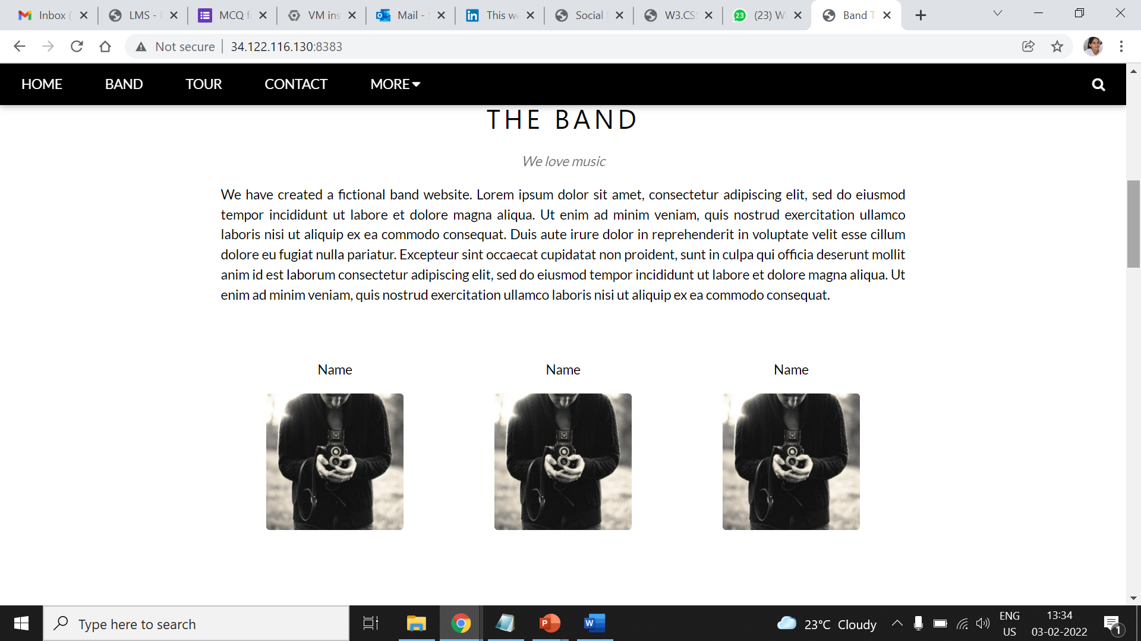
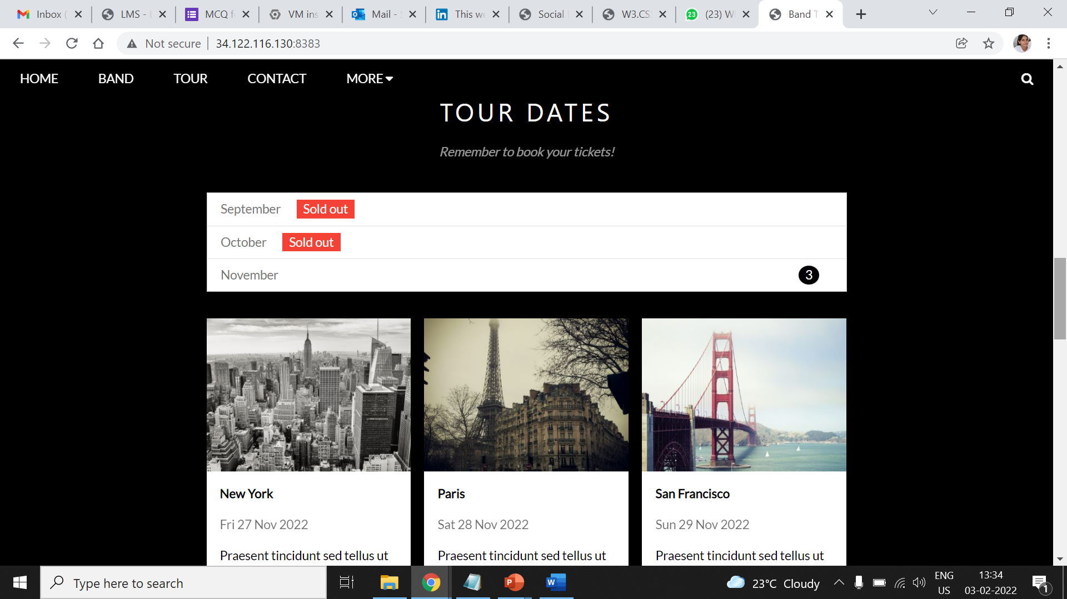
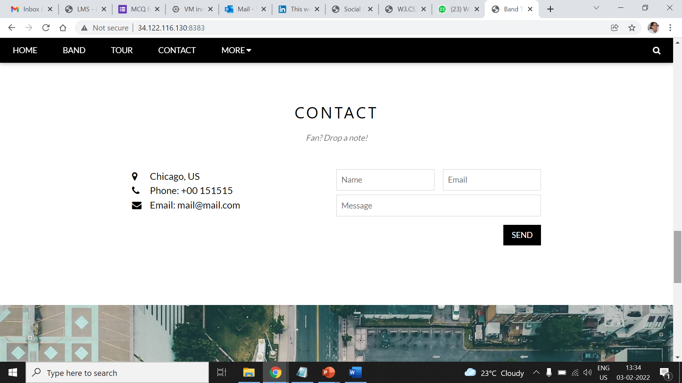
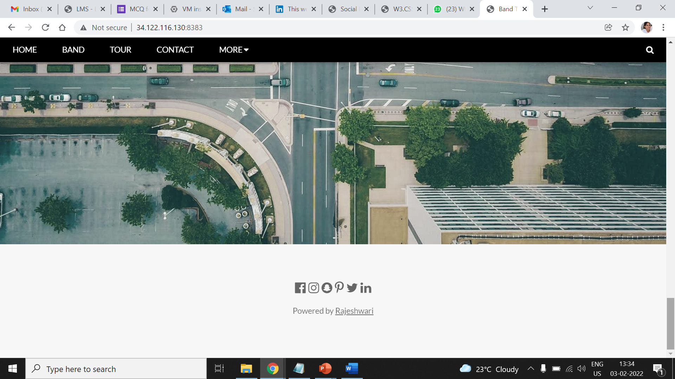
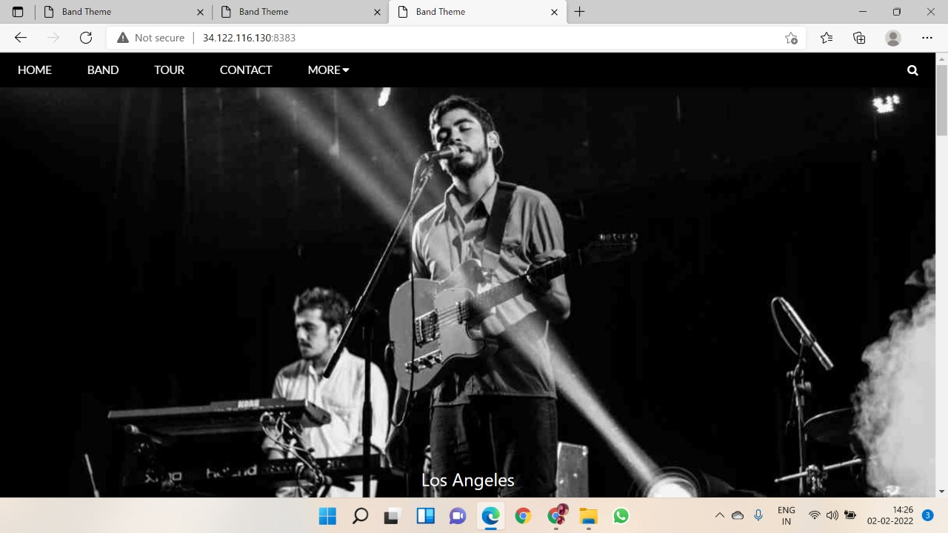
Project 2:Deployment of website on docker
http://34.122.116.130:8383

Slide 20
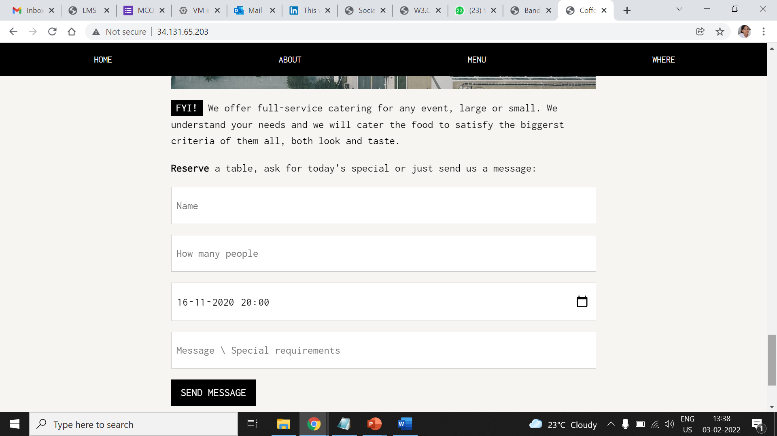
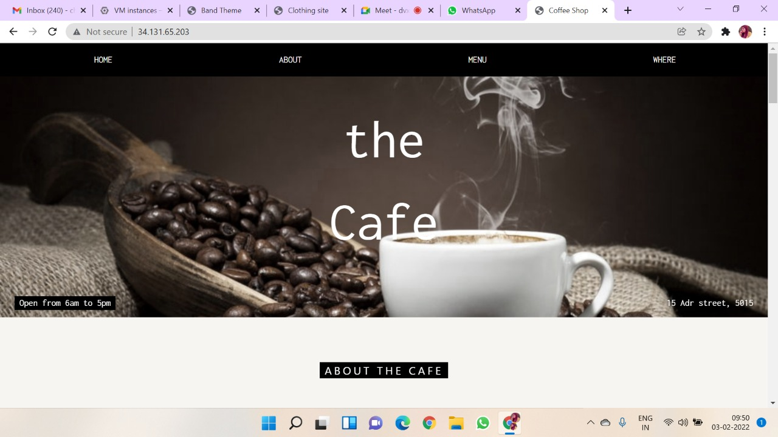
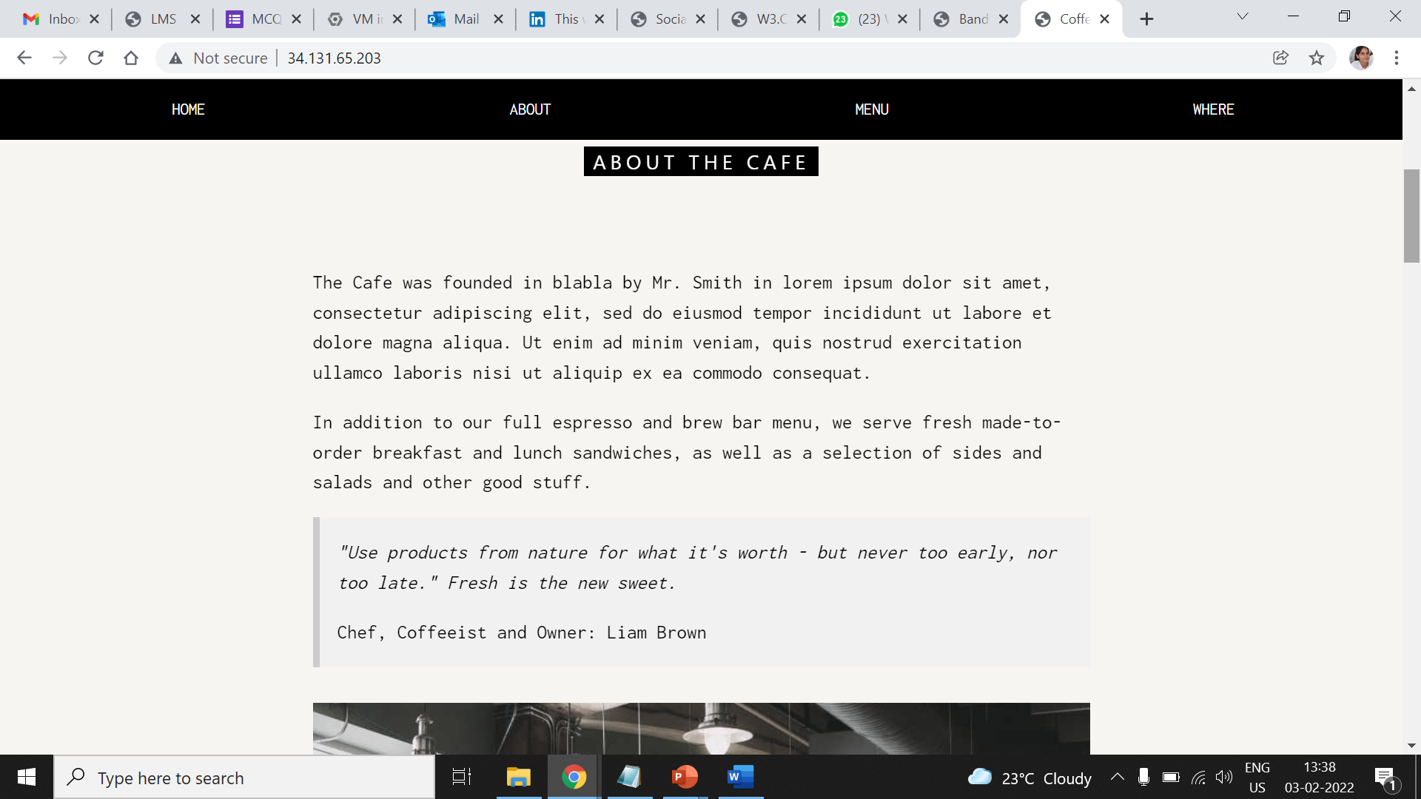
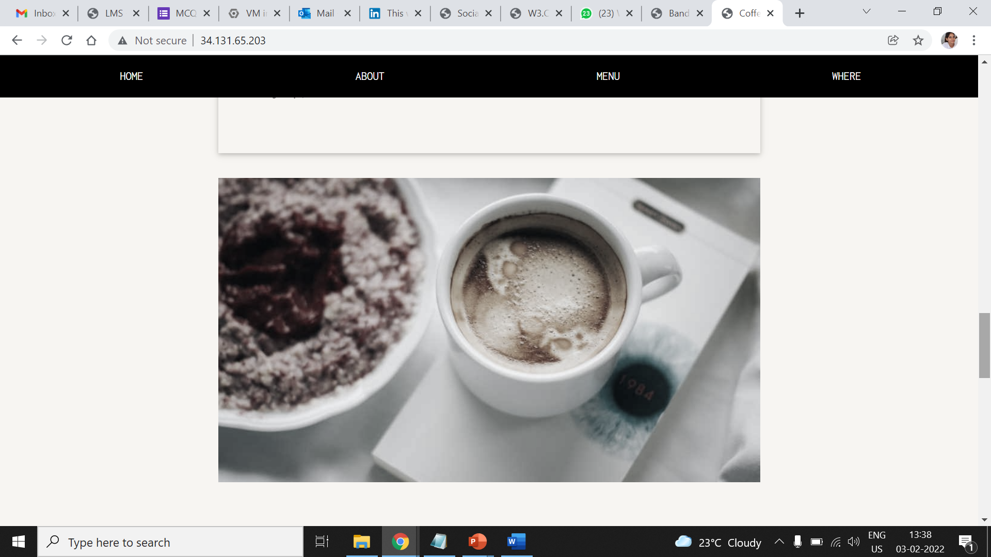
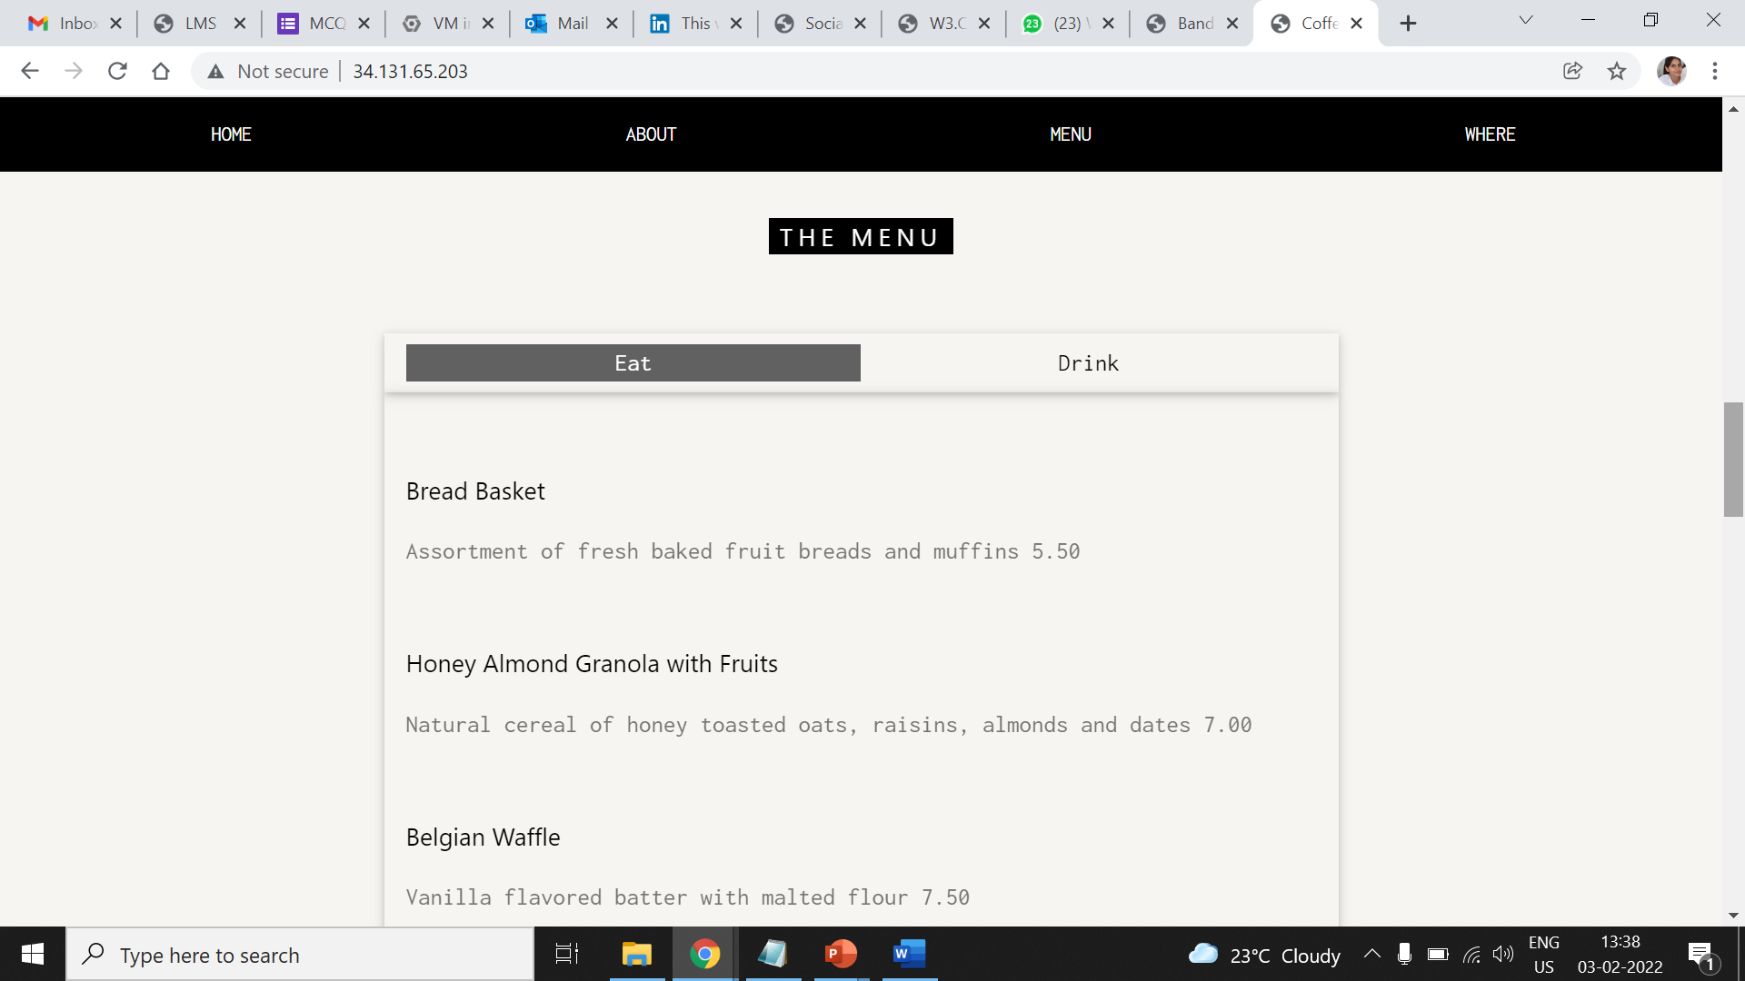
Project 1 :Static website on GCP
http://34.131.65.203/
Vasantha – Coffee shop

Slide 21
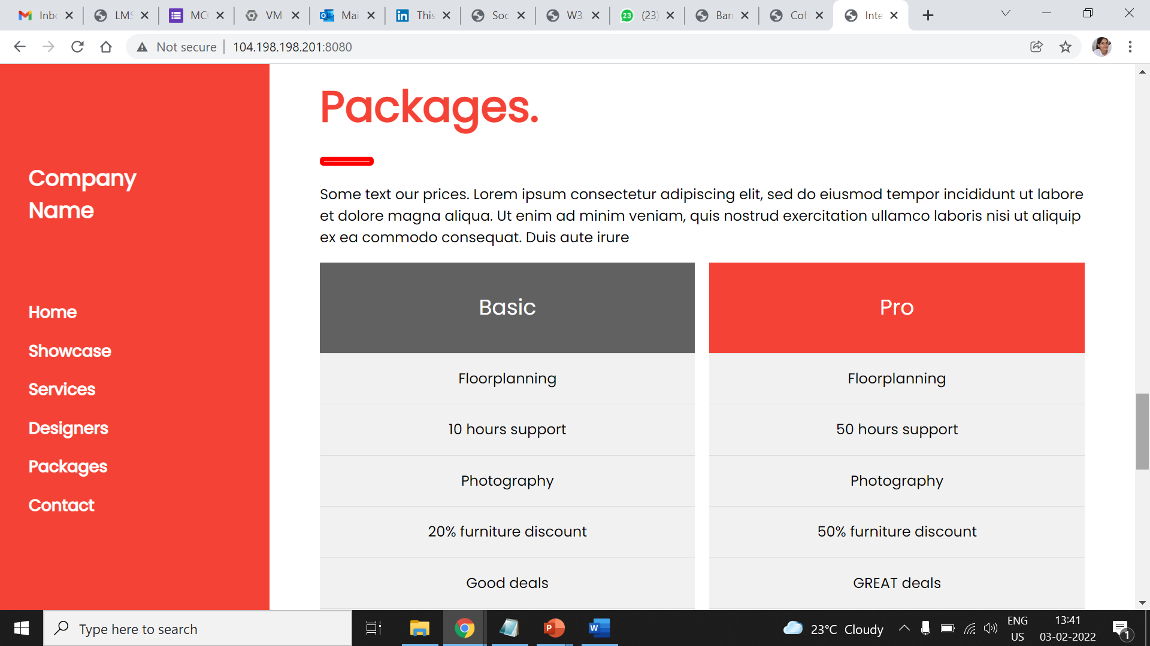
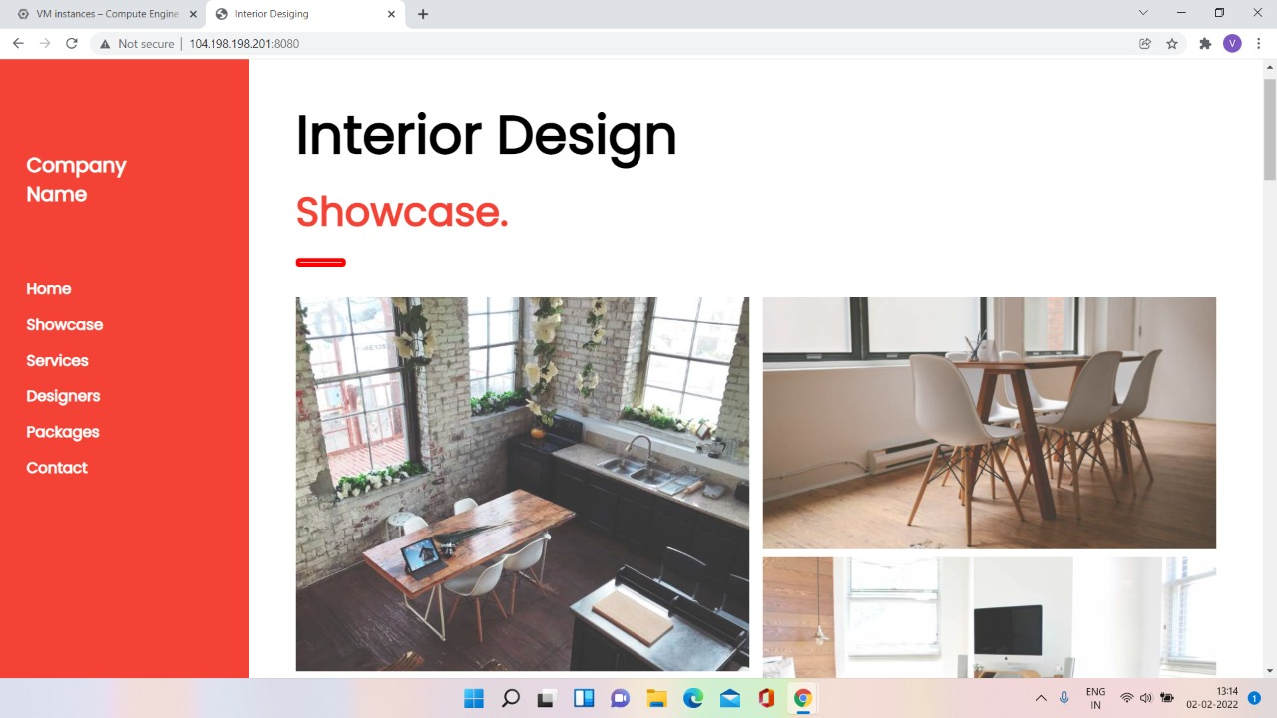
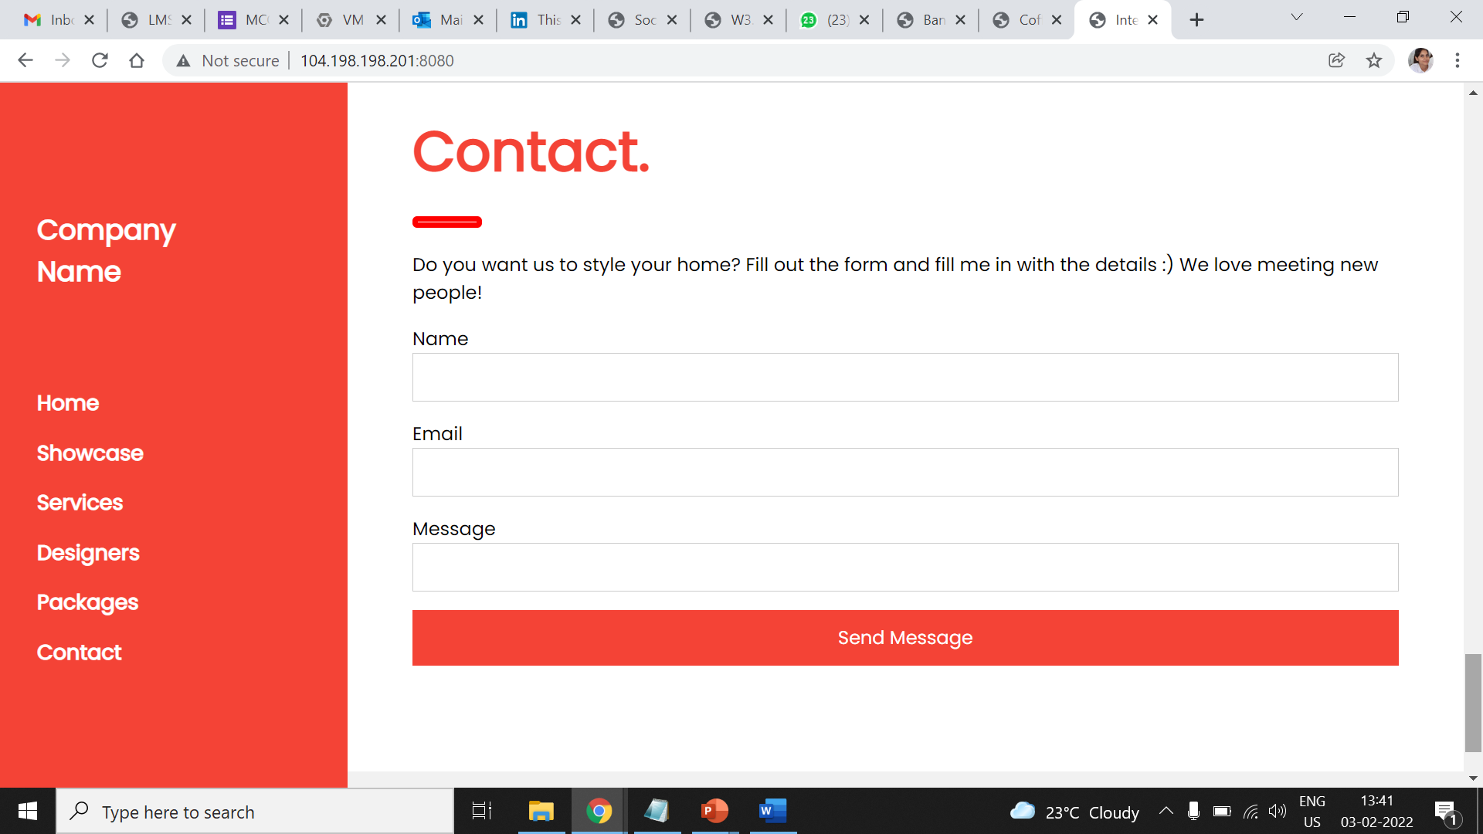
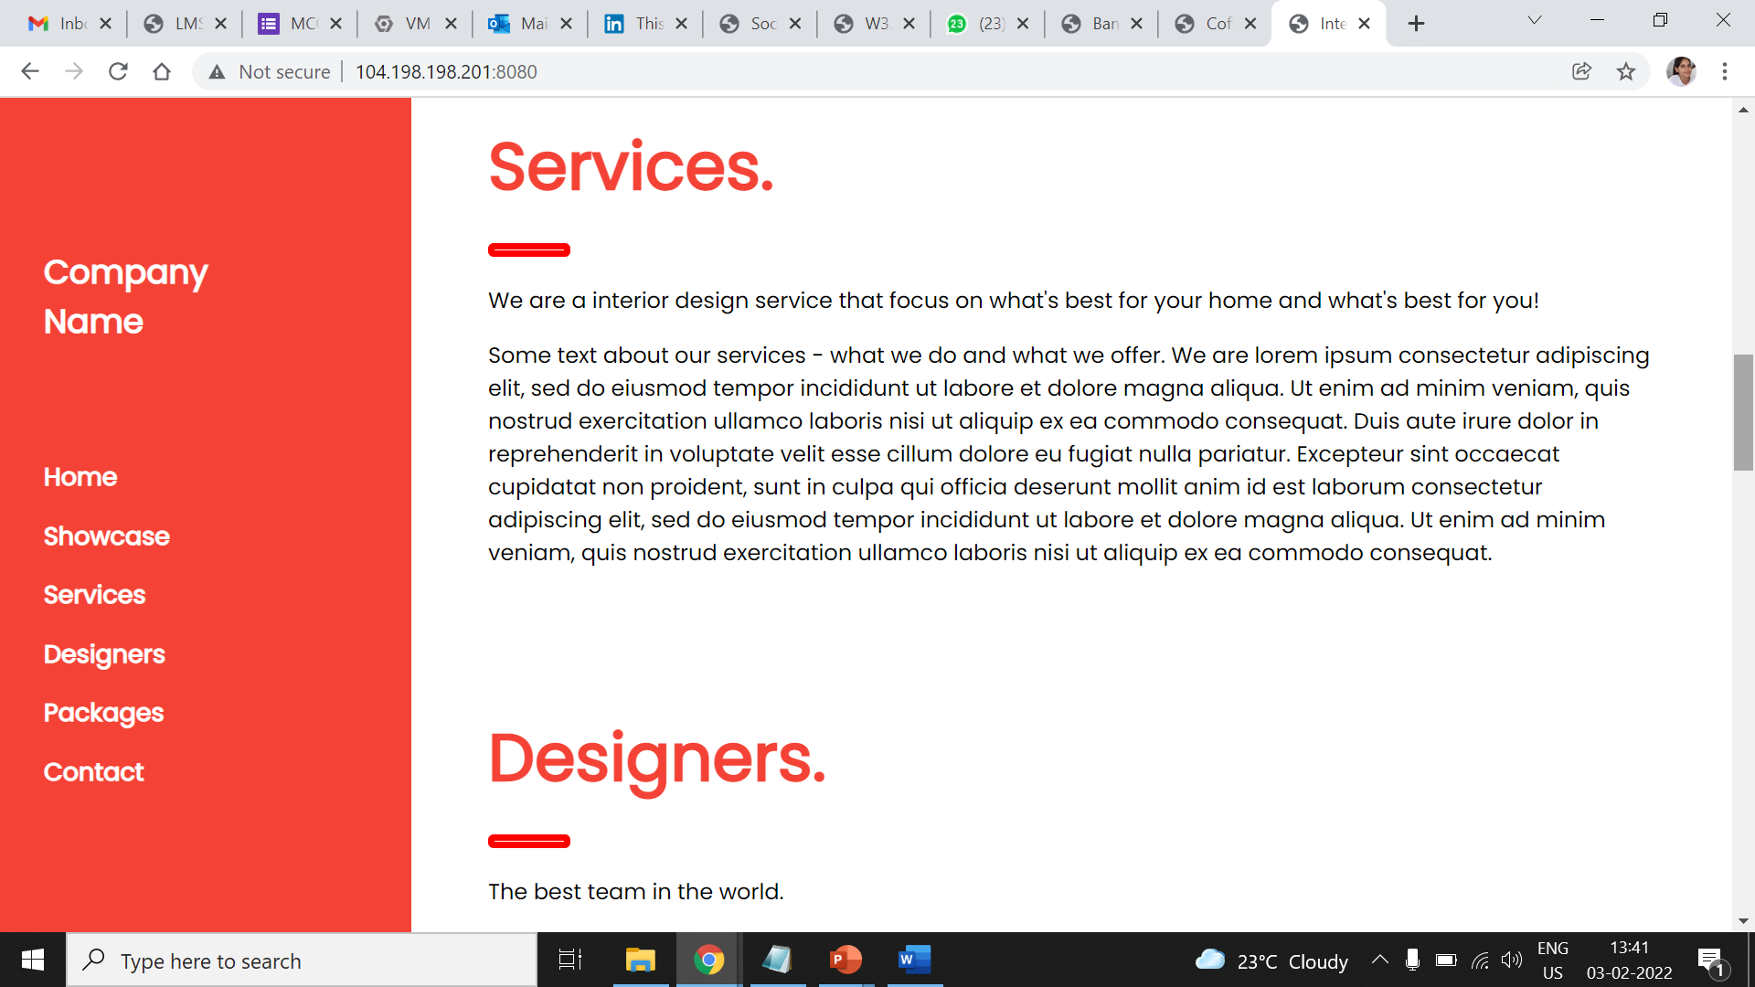
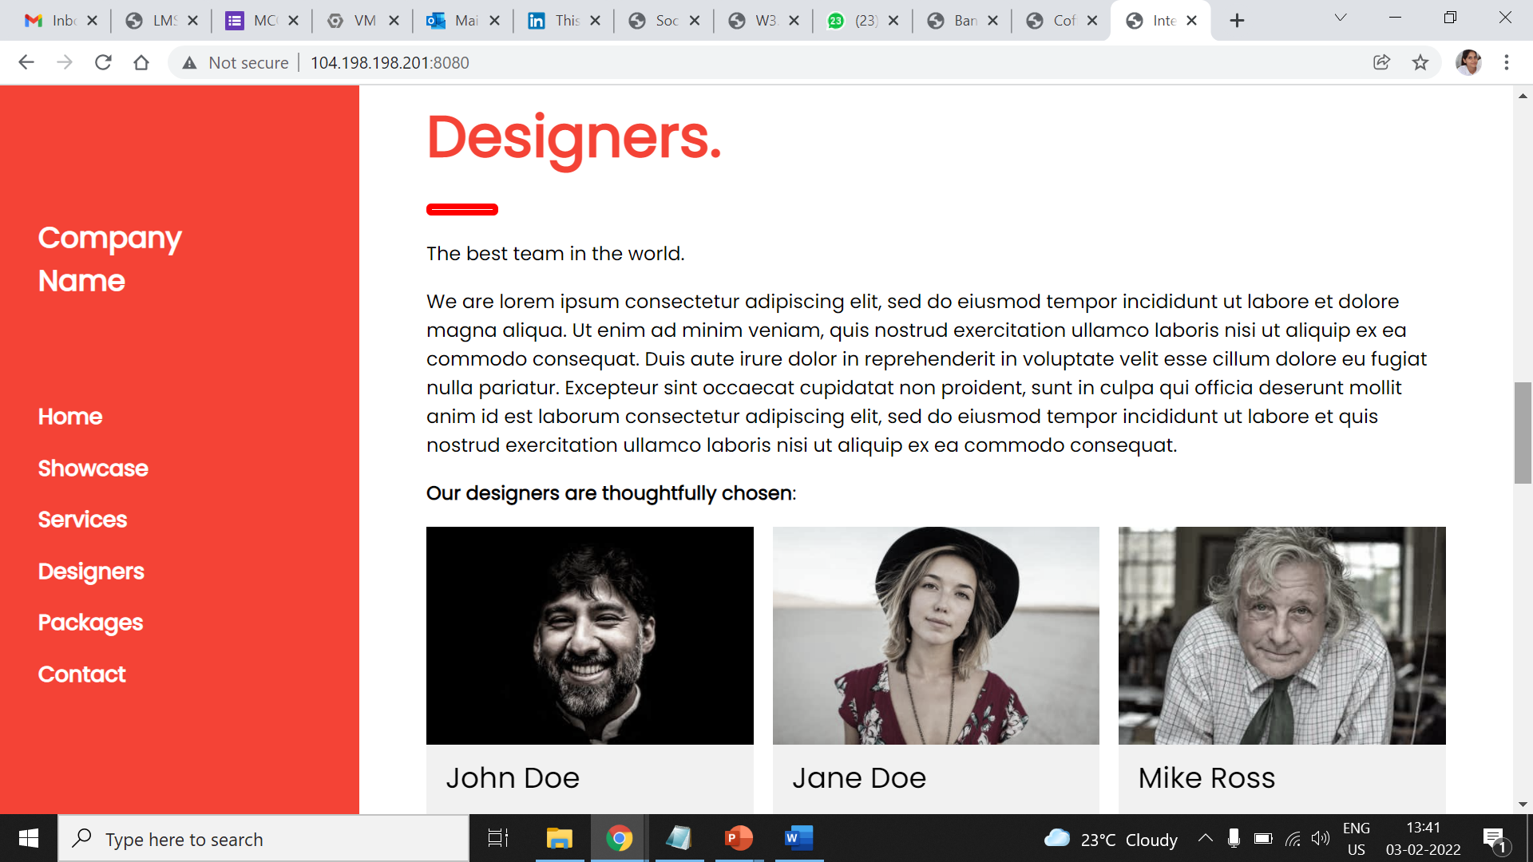
Project 2:Deployment of website on docker
http://104.198.198.201:8080

Slide 22


